Slide 1


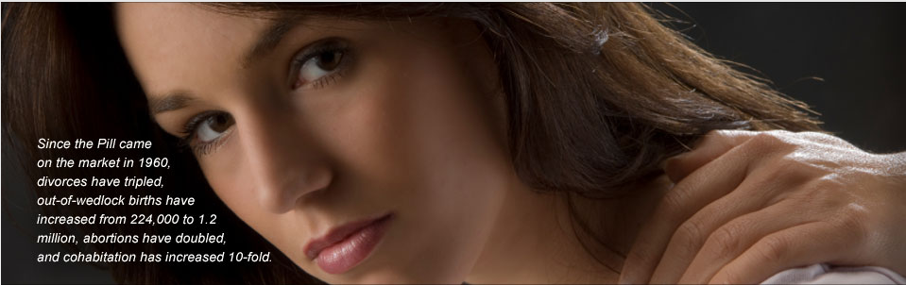


Welcome!
Part of the Office of Marriage and Respect Life
        Please sign in!
        Registration fee: $40.00 (cash or check payable to “Office of NFP”)
        Look over pamphlets and handouts in Intro packet
        Take out and begin filling out the “Qualities” worksheet
        Certificates of attendance to be distributed following the talk
Notes:
Have this up on the screen as people gather until you are ready to begin the presentation.

Slide 2


Diocese of Phoenix
Office of Natural Family Planning
Part of the Office of Marriage and Respect Life
Notes:
Welcome- The Diocese of Phoenix would like to extend a welcome to all of you:
Note: Marriage Prep requirements change Jan. 1, 2010 To those who are fulfilling marriage prep requirement to be married in the Catholic Church and especially those who are not Catholic and are here to support your Catholic spouse or fiancé (fiancée). We congratulate all of you who are taking the extra steps needed to receive the sacrament of marriage. This is a decision that will help you in your life long journey together
(Certificates will be handed out at the end of class.)
To those who are already married and are interested in information about NFP for health, relational, or moral reasons.
We would like to open by praying the Our Father together
Introduction
Ourselves/family,# yrs. married, #yrs used NFP (if applicable)
What qualifies us to teach / certification
Why we work in NFP
Suggest that couples introduce themselves to people on either side and share their wedding/ anniversary dates.
Why the Catholic Church Requires NFP Intro or soon the full series for all marrying in the church.
If here for marriage prep, you have asked to be married in the Catholic Church.
The Church believes marriage is indissoluble: “What God has joined together, no human must separate.” (Matt. 19:6)
The Church cares about your having a successful marriage.
The Catholic Church cannot condone contraception and wants you to know how to cooperate with God in planning your family in a generous and responsible way and to understand why NFP is endorsed by the Catholic Church. We are not here to judge you but rather to educate you more about the Church’s teachings of Christian Marriage.
The Church has deep respect for the gift of human sexuality.
The Church wants you to have truthful information about family planning that serves man, woman and child.
Purpose of Activity #1:
To give couples an opportunity to see that many of the qualities needed for a successful
marriage will be learned and exercised in the practice of NFP and will be transferred to other areas of their life together.
E.g.: selflessness, understanding, communication, etc. Refer to this activity at the end of class allowing them to see how these qualities will be used in the practice of NFP giving the skills necessary for a healthy relationship.
Activity #1 Qualities Sheet (from Intro Packet)
Encourage couples to list qualities that will help in making their marriage last. Suggest that they may already possess the quality or may wish to develop it further. Tell them it is not a test nor will it be collected. Give about 5 min to complete the activity, ask for volunteers to write on board, and then tell them you will refer to it later. You can tell them to remind you to come back to this.

Slide 3


Overview
Christian & Sacramental View of Marriage (Theological Foundation)
Scientific Basis of NFP: Anatomy, Hormones, Menstrual Cycle
Contraception & Unintended Effects
Effectiveness Rates
Your Next Step: Learning NFP
Notes:
Christian & Sacramental View of Marriage-Theological Foundation
Scientific Basis of NFP: Anatomy, Hormones, Menstrual Cycle
Contraception & Unintended Effects
Effectiveness Rates of NFP
How to learn NFP- this class is just an overview. In order to learn NFP you will need to take additional classes.

Slide 4
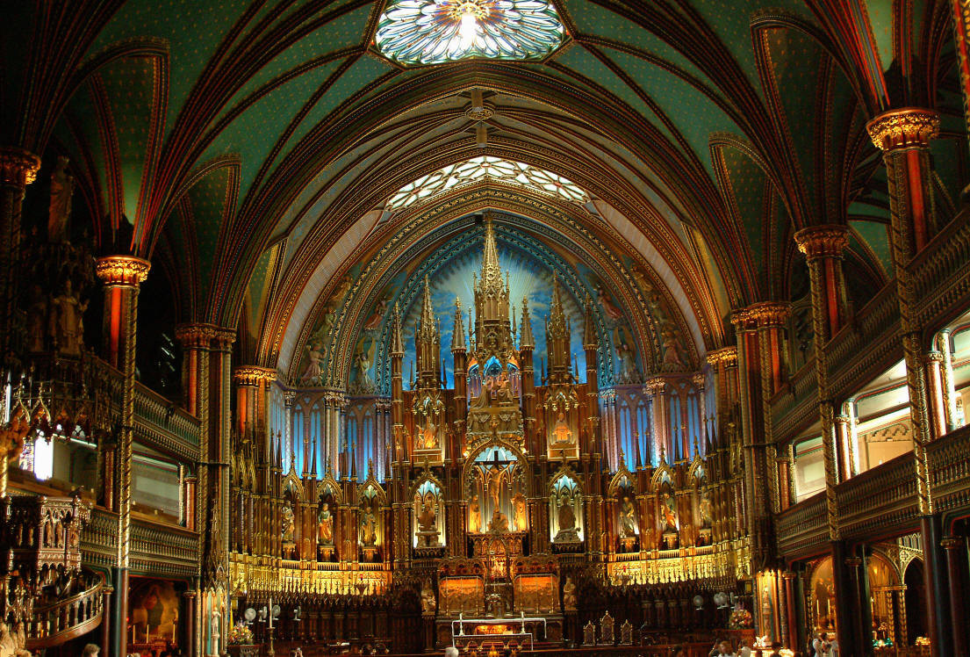

Sacramental Marriage In The Catholic Church
Notes:
Before we can talk about NFP, we need to understand the foundation on which Catholic teaching about family planning is based.
Audience Participation Activity #2:
Why do you want to get married in this day and age?
Why not just live together? (If you have board, list responses & include the following)
Commitment
lifelong promise of fidelity
to start a family
to ”legitimize sex”
Why do you want to get married in the Catholic Church? (Add to list if not mentioned.)
Hopefully you also want to invite God into your marriage, to receive the grace of the sacrament, to be a sign of God’s love to each other and to the world, to have a family and raise them with faith in God.
The difference between a civil and a sacramental marriage:
Civil marriage is a contract to stay together as long as both parties agree. Either party can break the contract by stating the marriage is irretrievably broken. Neither spouse nor the court/judge can prevent the breaking of the contract.
Sacramental marriage is covenant promises between two people with God as their witness and partner. Every marriage will have its challenges and where either human spouse may feel or think that the marriage is too difficult, and the forgiveness required is too big, the Church teaches that with God’s grace in the marriage, there is forbearance and redemption. We might fail, but Christ cannot fail.
Every sacrament makes visible an invisible reality. In order for us to understand what invisible reality is being made known to us through the sacrament of marriage we must go all the way back to the beginning, to the beginning of the Bible and the creation story.

Slide 5
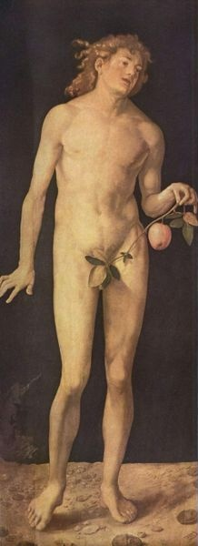
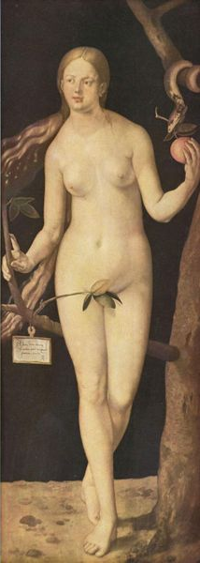
In The Beginning…
“God created man in his image; in the divine image he created him; male and female he created them.”
Gen 1:27
Notes:
(Personal story can be inserted: Beginning dating, wondering if this is right one for lifelong spouse….anxiety in wondering …)
In the first chapter of the first book of the Bible, Genesis, there are two accounts of the creation story. In the first account, we read:
[click] [read slide]
Man was created in the image of God: as male and female.
Each of us individually image God, but there is something unique in our being male and female that especially reveals who and what God is. God is Trinity
(Father, Son and Holy Spirit) He is a communion of love.
(Put another way, there is something we can learn about God by taking a closer look)

Slide 6
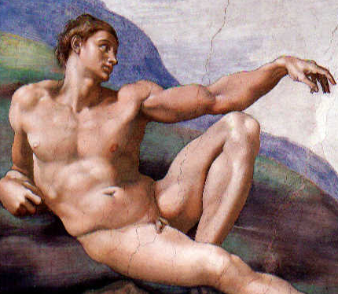
What’s Missing?
Adam is alone!
Animals: Bodies without spirits
Angels: Spirits without bodies
Adam: Embodied Spirit
Notes:
In the second creation account in Genesis, God first creates Adam.
But Adam has a problem.
Adam’s problem is that he is alone.
God created animals that are merely creatures with bodies but without spirit.
God also created angels which were creatures of pure spirit without bodies.
But God made Adam unique – he was made with body and spirit.
He instinctively knew that he was alone.
(If any have ever felt that anxiety, it must have felt a little like Adam felt)

Slide 7
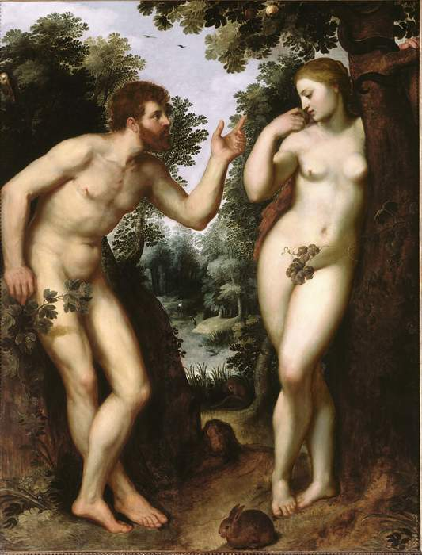
At Last!
Eve is created from the side of Adam.
They are from the same body.
They share the same nature!
“This at last is bone of my bones and flesh of my flesh!”
Notes:
And then, God created Eve from the side of Adam. (Not the head or foot, but the side)
This means they were made from the same body & shared the same nature.
This created a new possibility for Adam that the animals and angels could not provide…a relationship known as communion.
We read how Adam expressed profound joy at the sight of Eve. (read quote on slide)
The invisible reality that is made visible in the sacrament of Marriage is that of the image of God. The Image of God is a communion and union of self giving love. In fact, John Paul II said, in Theology of the Body, “Man becomes the image of God not so much in the moment of solitude as in the moment of communion.”
(TOB)

Slide 8
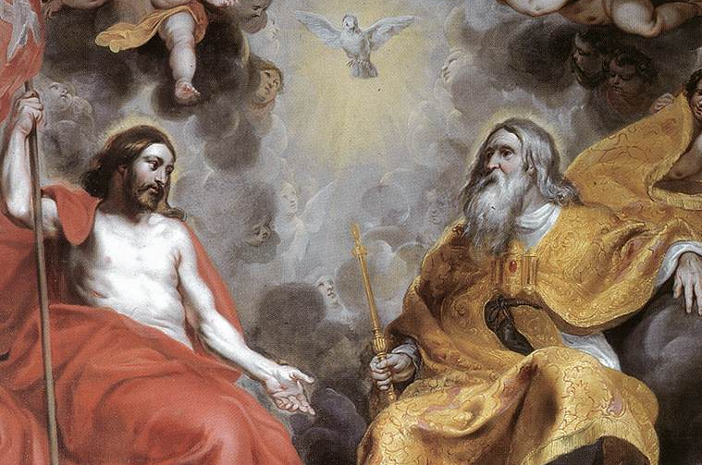

Love is Trinitarian
The Father pours himself out in love to the Son.
The Son pours himself out in love to the Father.
The Holy Spirit bursts forth as the fruit of their self-giving love.
“Let us make man in our image…”
Gen 1:26
God is…
A union and communion of fruitful, self-giving love.
Notes:
The reason for this is that as Catholics we believe that God is a Trinity.
[click]
The Father pours himself out in love to Son.
Son pours Himself in love to the Father.
Holy Spirit bursts forth as the fruit of their self-giving love.
[click]
God is…A union and Communion of fruitful, self giving love.
Through the Sacrament of Marriage we see the image of God as the Trinity.
The visible reality of the Sacrament of marriage is the husband giving of himself in a sincere gift of love to his wife and the wife giving of herself in a sincere gift of love to her husband and their love bursts forth fruitfully, sometimes as another person, their child.
Therefore: “Man becomes an image of God not so much in the moment of solitude as in the moment of communion.” TOB
Read quote on slide:
This means that “man is called to exist ‘for’ others, to become a gift”
(JPII, “On the Dignity and Vocation of Women”)
Remember: we said we can learn something about God from our “male-ness” and “female-ness”
What we learn is that we were made this way in order to become a union & communion through a sincere gift of self, with our body and spirit. Marriage is one of the deepest ways humans can image God.
How do you actually do this? How do you become a gift to another person? Our fallen natures don’t make this an easy thing. That’s one reason why we substitute things for the gift of ourselves.

Slide 9


Before Sin
After Sin
Body and Spirit were perfectly integrated
Body and Spirit became ruptured
Notes:
It didn’t used to be so hard. Before original sin, there was a perfect unity, a perfect harmony between body and spirit. Our spirit, will, emotions and bodies were all in cooperation with each other. In this way, we experienced perfect joy.
But…
[click]
Original sin created a rupture between our heart and mind, our spirit and body
Instead of seeing a person as someone we can give ourselves to, our fallen nature leads us to see others as “objects” that we can use to satisfy our own desires.
(It’s been said the opposite of love isn’t hate… it’s use)
We are all subject to this reality… (Examples: men have misused their strength to dominate women; women have misused sex to manipulate men)

Slide 10

Good News!!
We are redeemed!
Not just our spirits but our bodies too.
“The fruit of redemption is indeed the Holy Spirit”
TOB, 3/18/81
We should experience a new holiness of the body.
This is why marriage is a sacrament.
Notes:
But, there is GOOD NEWS!
God redeemed us by His Cross and Resurrection.
Redemption isn’t just a spiritual thing. It’s a bodily reality.
The deaths and Resurrection of Christ allow us to make a sincere gift of ourselves because of the grace of the Holy Spirit.
Pope John Paul II said– “Fruit of redemption is the Holy Spirit”
The graces we receive in the sacraments give us the opportunity to experience a new holiness.
This is why Marriage is a Sacrament – in marriage we receive the grace to live sacrificially and to give ourselves in service to the other. The struggles do not cease, but overcoming them and persevering through is possible through God’s grace.
Grace leads us back to the kind of true happiness we were made for!
(Consider the first miracle Jesus performed: turning water into a fantastic wine at the Wedding at Cana. We can see that Jesus wants to bring greater joy to our marriages if we would only invite him.)

Slide 11


Marriage is a Sign of Christ’s Love for Us
Total
Free
Faithful
Fruitful
Notes:
Every sacrament is a sign of a greater reality.
There are signs all around us. Signs that tell us about companies, restaurants, sports teams, countries and everything else. Signs remind us of larger realities. The golden arches make us think about hamburgers, the stars and stripes make us think about our country, patriotism, heroes, and so on.
Marriage is also a sign. What is it that people are supposed to see when they look upon us as married couples?
[click]
Marriage is a sign of Christ’s love for his bride, the Church.
The grace of the Holy Spirit empowers us to give ourselves to each other the way Christ gives himself to the Church:
[click] Freely – chose to give himself (ref. “The Passion”)
[click] Faithfully – Followed through, still with us, sacramental grace
[click] Fruitfully – His death led to Easter which made way for Pentecost and the new life of the Holy Spirit. Christ said, “I came that they may have life, and have it abundantly.” This abundance of life is possible – within our marriages! We can achieve the happiness we seek if we allow ourselves to become this sign that marriage is supposed to be.
[click] In short, Christ’s gift of himself to his Bride was TOTAL.
He held nothing back, gave all of himself. Isn’t that what we intend to do on our wedding day – to give ourselves totally to each other? Holding nothing back? “For as long as we both shall live”?

Slide 12
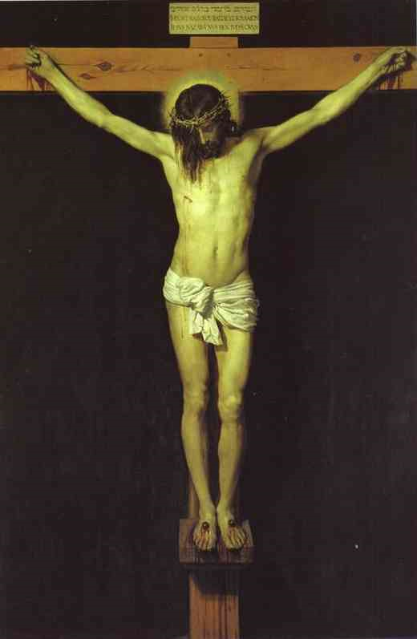
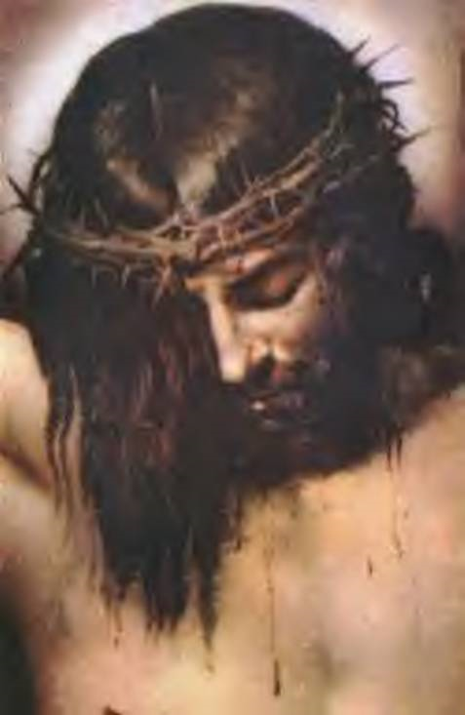
Total
This is the language of marital union:
“This is my body given up for you.”
Notes:
If we want to know how to make a total gift of ourselves to our spouse, we should look no further than Christ and Mary.
Jesus showed us what TOTAL looks like.
[click]
The language of sex is, “I give myself to you totally.”
Married couples say this to each other at the altar and say it every time they join in the marital embrace. That’s the language of the body. We pray a lot more than we realize!

Slide 13
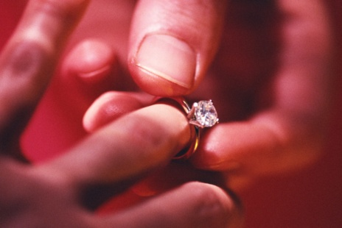
When You Marry
“Have you come freely,
without reservation?”
Free
Total
“Will you love and honor each other as man and wife for the rest of your life?”
Faithful
“Will you accept children lovingly from God?”
Fruitful
Notes:
On our wedding day, we promise to love our spouse in the same way Christ loves his Church.
Before we make our actual vows, we first have to give our consent. The priest asks us three questions:
[click]
Have you come freely, without reservation? – Our “yes” says that we are making a free gift of ourself, holding nothing back
[click]
Will you love and honor each other as husband and wife for the rest of your life? – Our “yes” says that we intend to be faithful to our dying day, never intending to divorce.
[click]
Will you accept children lovingly from God? – Our “yes” says that we intend to be fruitful, never intending to willfully sterilize our union.
What we say at the altar with our words we say in the bedroom with body language.
In fact, the Church explains that the vows we make at our wedding are sealed when we consummate our union in the marital embrace.
[click]
Marital union says with our body, “I give myself to you TOTALLY.”
(Explain why pre-marital sex is not truthful; does not seal any promise.)
Where does the Catholic Church fit in this?
The Church has always had a reverence for the Sacrament of Matrimony so much so that it has never changed its teaching about marriage. The teachings have always protected the vows a couple makes to each other and to the whole community. In respecting the importance of freedom it will never agree to marry a couple who feels forced to marry or will declare that a marriage was null and void as a sacrament (annulment) from the very beginning if a couple is found to have not possessed full freedom when they married.
(This freedom mirrors the freedom of our Creator as He chose to bring us into existence creating us to be a “gift” for others.)
The Church has always upheld fidelity in marriage and therefore condemns sins against lifelong faithfulness such as extramarital relationships. It likewise does not recognize the civil dissolution of the marriage or divorce.
(In making and living a commitment to fidelity for life, we show to our spouse and others an image of the unlimited faithfulness of our God to us.)
In marriage couples are asked to submit to one another and to love as Christ loved the Church. We make a “gift” of ourselves to our spouse. This highlights the totality of our self-giving that we are trying to attain. This means that we withhold nothing including our ability to bring a new life into existence.
(When Christ gave Himself to us, even to the point of death that we might live for eternity, He withheld nothing from us giving us a total “gift” of Himself.)
When the Church asks us to accept children, we are agreeing to be fruitful and that in our love-making we will do nothing prior to, during or afterwards to prevent a child’s conception when we unite as a couple.
(God’s love for us is fruitful as He calls each of us into existence and as He gives life to all around us.)

Slide 14




Body Language
The body reveals God
Especially in marital union
But the body can also lie!
Holding something back becomes a counter-sign.
“I give myself to you totally.”
Notes:
Let’s talk about body language for a moment.
(Guys: How many of you got down on one knee when you proposed? What message were you trying to send at that critical moment?
Ladies: After he proposed, did you hug him? Kiss him? Hold his hand? What message were you trying to send in return?)
Our bodies speak a language all their own.
The Body reveals God
Remember – God made us and our bodies to be a visible sign of his presence in the world.
[click]
We mirror God in our relationship as husband and wife and we especially speak about God with our bodies in the marital union!
[click]
What happens if we speak a lie to someone while we’re looking them straight in the eye? What is a “poker face” if not an act of deceiving other poker players with our expressions?
We see that it is possible to lie with our body.(ie.,Lying under oath, lie detectors, playing poker)
So, the body can speak a truth or a lie about God.
How can we know when we’re speaking the truth about God with our bodies?
What are other ways you think in your day-to-day marriages your bodies will mirror the image of God?
[class participation]: patience, kindness, self-sacrifice, gentleness, honesty, doing dishes, changing diapers, giving backrubs, leaving the toilet seat down, etc… and one other way – marital union!

Slide 15

Body Language
Marriage and the body are signs of God’s love!
But the body can also lie!
Holding something back becomes a counter-sign.
Notes:
To look at a few sources of Catholic teaching on sexual expression of love we cite:
Catechism of the Catholic Church:
“Sexuality, by means of which man and woman give themselves to one another through the acts which are proper and exclusive to spouses, is not something simply biological, but concerns the innermost being of the human person as such. It is realized in a truly human way only if it is an integral part of the love by which a man and woman commit themselves totally to one another until death.” (Catechism 2361 – Familiaris Consortio)

Slide 16


What God Has Joined…
Unity
Procreation
“The spouses’ union achieves the twofold end of marriage: the good of the spouses themselves and the transmission of life.
“These two meanings or values of marriage cannot be separated without altering the couple’s spiritual life and compromising the goods of marriage and the future of the family.”
CCC 2363
Notes:
God built two things into sex: Unity and Procreation
Sex is obviously a very bonding activity, and it naturally leads to children
God in his very being is both unitive, A Trinity or a union of persons, and fruitful, living in fruitful, self-giving love.
So it makes perfect sense that gift of married sex, which contains these exact same elements would be the perfect sign of the love of God.
Here is what the Catechism of the Catholic Church says about this:
[click]
Catechism 2363: “The spouses' union achieves the twofold end of marriage: the good of the spouses themselves and the transmission of life.”
Good of the spouses: “Unity” (bonding)
The transmission of life: “Procreation” (babies)
[click]
“These two meanings [bonding and babies] or values of marriage cannot be separated without altering the couple's spiritual life and compromising the good of marriage and the future of the family.”
What three things does this say will be harmed if we separate bonding from babies?
Couple holiness
Unity of Marriage
The Family

Slide 17


Catholic Sexual Morality In A Nutshell
SEX
Law #1: Keep Sex in Marriage
Loving, Covenantal
Adultery
Pornography
Babies
Divorce
Abortion
Marriage
SEX
Rape
STDs
Sexual Abuse
Bonding
Incest
Extra-Marital Sex
Homosexual Acts
Notes:
Here is a really simple way to look at this. “We call it Catholic Morality in a Nutshell”
[click]
Let’s say that this circle represents a loving, covenantal marriage
[click]
and inside this circle is where all sex happens.
[click]
And remember the 2 fold purposes of sex- for Babies and for Bonding.
There are only 2 rules inside this circle and Rule #1 is always followed:
[click]
Keep Sex inside Marriage
If everyone in the world lived like this, what issues or societal ills would we not have in the world? (ask for class participation first, then Click to see societal ills pop up.) Separating babies from bonding harms in four ways:
Harms marriage – our connection to our spouses, unfaithfulness
Harms family – our connection to our children and extended family, what we’ve received we don’t pass on…
Harms spiritual life – our connection to God, honesty, integrity is compromised
Harms society-divorce, poverty, diseases, health issues

Slide 18
Law #1: Keep Sex in Marriage
Law #2: Don’t Separate the Two Purposes
Loving, Covenantal
Adultery
Embryo Grading
Pornography
Selling Eggs
In Vitro, Artificial Insemination, etc.
Babies
Divorce
Abortion
Embryo Destruction
Marriage
SEX
Sperm Donors
Rape
STDs
Freezing Embryos
Contraception & Sterilization
Sexual Abuse
Bonding
Incest
Pregnancy “Reductions”
Extra-Marital Sex
Surrogate Motherhood
Homosexual Acts
Notes:
Rule #2
The second rule is: Don’t Separate the Two Purposes. Again, don’t separate the twofold ends of marriage: Babies and Bonding.
If everyone in the world lived with this rule, what issues would we not have in our society?
[click]
and up pops: frozen embryos, IVF, abortion used for sex selection, babies made to our preference, not received as a gift from God… etc….
Notice that everything that results from separating Babies and Bonding hurts people. Our Church is like a good mother and good mothers always tell us not to hurt others or ourselves.

Slide 19
Yes!
Is This Possible?
Loving, Covenantal
Sacramental
Embryo Grading
Selling Eggs
In Vitro, Artificial Insemination, etc.
Babies
Embryo Destruction
Grace
Marriage
SEX
Sperm Donors
Freezing Embryos
Contraception & Sterilization
Bonding
Pregnancy “Reductions”
Surrogate Motherhood
Notes:
The real question: Is it possible to live in this way?
[Click]
Yes! Not easy without the grace of the sacrament. In fact, there really is
a 2nd ring of protection around sacramental marriages that is the protection of God’s grace in marriage, giving couples the ability to live in this way.

Slide 20

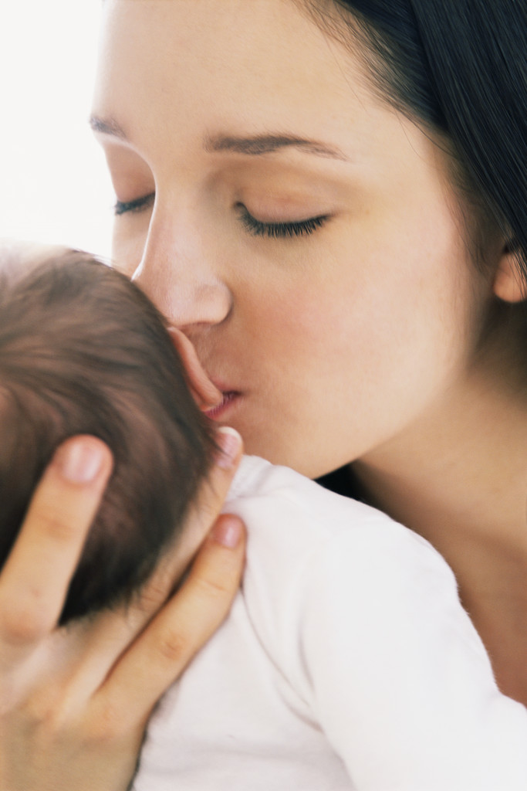
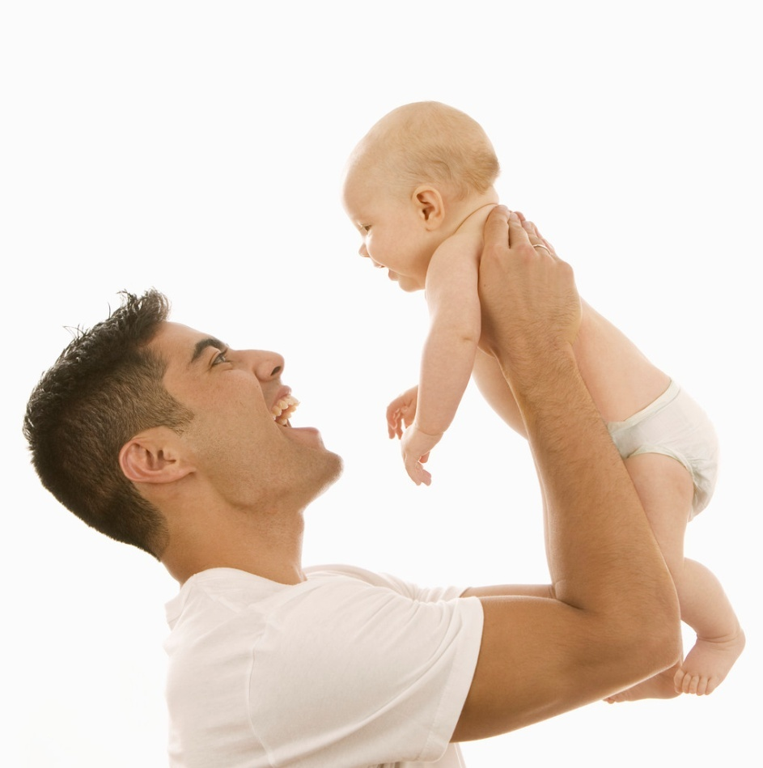


Always a Blessing
“My yoke is easy, and my burden light.”
Mt 11:30
Notes:
In addition to being free, faithful, total and fruitful in our marriages, the Church calls us to be responsible and generous in our decisions to avoid or achieve a pregnancy. The Church proposes a new way of thinking about children. The Church proposes that:
Babies are always a blessing and Not the burden that society thinks they are. There are definitely challenges and frustrations in raising children sometimes, but they are far outweighed by the blessings that children bring to a family.
[click]
In fact God will help us with those challenges and that burden….( Bible quote)
Children help us to grow in holiness and become better people as we raise them. (The children raise the parents!)

Slide 21

Responsible Parenthood
Humanae Vitae, Article 10
Humanae Vitae, Article 16
“If…there are well-grounded reasons for spacing births…, the Church teaches that married people may then take advantage of the natural cycles immanent in the reproductive system and engage in marital intercourse only during those times that are infertile, thus controlling birth in a way which does not in the least offend the moral principles...”
“…(R)esponsible parenthood is exercised by those who prudently and generously decide to have more children, and by those who, for serious reasons and with due respect to moral precepts, decide not to have additional children for either a certain or an indefinite period of time.”
Notes:
Let’s read what the Church has to say about Responsible Parenthood ***Show slide after HV quotes. (Could have a volunteer read the slide)
Even so, in a Christian marriage we are not expected to have as many children as possible.
We are expected to be responsible: what does responsible mean? Love, nurture, educate to being a fully alive human being….
Humanae Vitae written by Pope Paul VI – after Pill – Restated constant teaching of the Church.
Humanae Vitae: "In relation to physical, economic, psychological and social conditions, responsible parenthood is exercised either by the well thought out and generous decision to raise a large family, or by the decision , made for serious motives and with respect for the moral law, to avoid a new birth for the time being, or even for an indeterminate period. (HV 10)
[click]
Humanae Vitae: “If therefore there are well-grounded reasons for spacing births, arising from the physical or psychological condition of husband or wife, or from external circumstances, the Church teaches that married people may then take advantage of the natural cycles immanent in the reproductive system and engage in marital intercourse only during those times that are infertile, thus controlling birth in a way which does not in the least offend the moral principles which We have just explained.” (HV 16)
Responsible parenthood begins with consciously being aware when we choose to have sexual relations that we may conceive a child. We are directed by the Church to act responsibly and generously, both in making the decision to try to have another baby or to postpone having another child, even indefinitely. There may be times in marriage when it is prudent to postpone or avoid pregnancy, for good reasons. A couple using NFP will learn to recognize when they are fertile and abstain during that time – this does not violate vows but rather strengthens them.

Slide 22
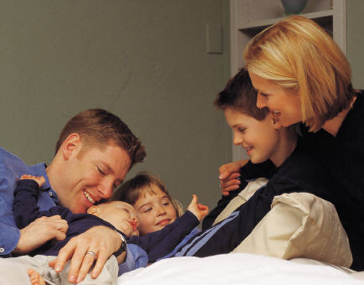
Should we have a baby?
Society asks:
Why?
The Church asks:
Why not?
Notes:
We are asked two very different questions when talk about having babies arises.
Society asks: “Why would you have another baby?”
The Church asks: “Why would you not have another baby?”

Slide 23

Virtues of Periodic Abstinence
Better communication
Enhanced intimacy
Self-mastery
Mutual respect
Continued enthusiasm
Less than 4% divorce rate
Husband’s increased understanding of wife’s fertility cycles
Notes:
In abstaining from marital relations during the possible fertile times because the couples has just and prudent reasons to do so, certain benefits or virtues can be experienced by a couple. These same benefits are also experienced by engaged couples who abstain before marriage
If not avoiding pregnancy, you may still find it helpful to have periodic abstinence during other times of cycle
[click]
Better Communication – Couples must talk openly about their sexual needs and desires, readiness for a child. Discussion and decisions in these areas foster communication in other areas.
[click]
Enhanced Intimacy – Couples learn to express love and affection in non-genital ways during fertile time thus fostering intimacy even if intercourse is not available.
[click]
Acquisition of Self-mastery – Both husband and wife grow in self mastery as they learn to control their sexual desires for the good of the other. They make a choice to freely give to and receive each other in their love-making. They find out that if one can’t say no, what does their yes really mean? We are not merely subject to our feelings and desires.
[click]
Mutual Respect – Men learn to appreciate the woman’s beautifully complex reproductive system and her potential to bear his children. She is more than an object of his pleasure and gratification. Women experience greater trust in their husbands and their ability to master sexual desires. The restraint on the part of both man and woman is a testimony of mutual love and commitment to shared goals.
[click]
Continued enthusiasm – Fosters the Courtship/Honeymoon scenario through a “time of longing” and a “time of fulfillment” each cycle. In avoiding intercourse during the possibly fertile times because the couple has just reasons to do so, certain benefits or virtues can be experienced by a couple.
[click]
Lower Divorce Rates- In the many studies associated with various methods of NFP, divorce rates are always below 5%.
[click]
Husbands knowing wife’s fertility cycle

Slide 24
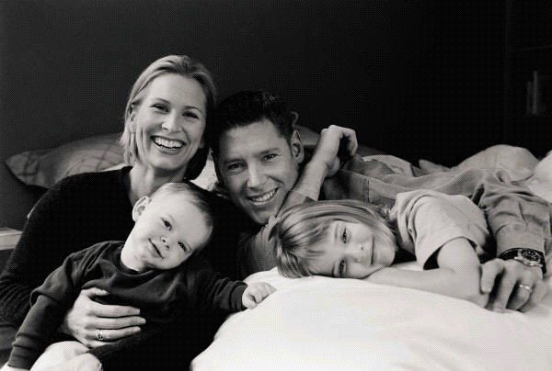
Our Right?...
God’s gift
?
...or
Notes:
Do we have a “right” to have children by virtue of our marriages?
Not every couple who marries will be able to conceive a child. something owed to one, but a gift. A child may not be considered a piece of property, an idea to which an alleged “right to a child” would lead. In this area, only the child possesses genuine rights; the right “to be the fruit of the specific act of the conjugal love of his parents,” and “the right to be respected as a person from the moment of his conception.” (Donum vitae II. 8)
Because we mistakenly may perceive children as a “right” rather than a gift, we then conclude that we can use any means available through fertility procedures to ensure a child for ourselves.
Intro Pack:
Refer to
“Evaluation & Treatment of Infertility”
In your packet of information there is a sheet describing fertility procedures and what is morally permissible.
Keep in mind that many infertile couples choose to express their openness to life through adoption.

Slide 25
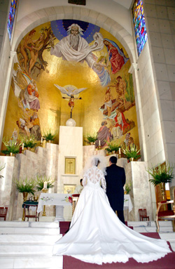

The Beauty of God’s Design
What God has joined man must not divide.
Notes:
The great tragedy is that so many couples today have been duped - deceived into believing that using contraception in their marriages is a morally upright and just behavior. We can hardly fault young couples for thinking this way because our culture has become so saturated with the thought that sex and parenthood are completely separate entities. Consider the difference between the two phrases: “I want to have sex with you.” vs. “I want to bring a baby into the world with you.” These two phrases shouldn’t mean two different things, but in today’s culture they do.
[click]
The beauty of God’s design, the beauty of marital love is that what God has joined, man must not divide.

Slide 26

Take a Break!
Two minutes! Stretch, quick drink
Be sure to register if you haven’t already
Notes:
MIDWAY POINT
Point out where bathrooms.
and drinking fountains are located
Click the “play” button in the bottom-right corner to start the “History Of NFP” slide. This slide will loop until you click the “play” button again.

Slide 27
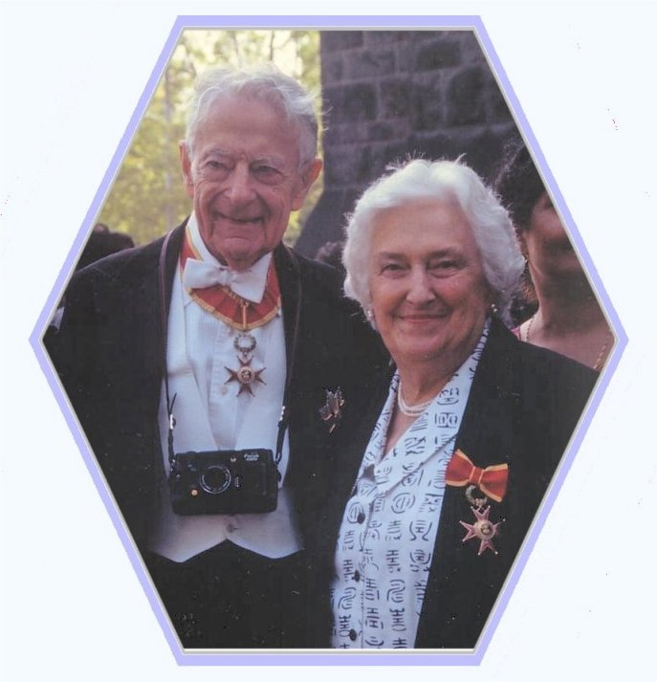
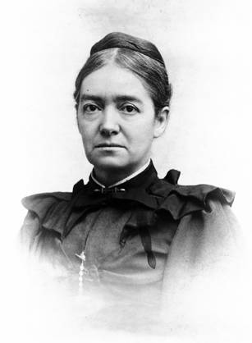

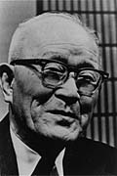
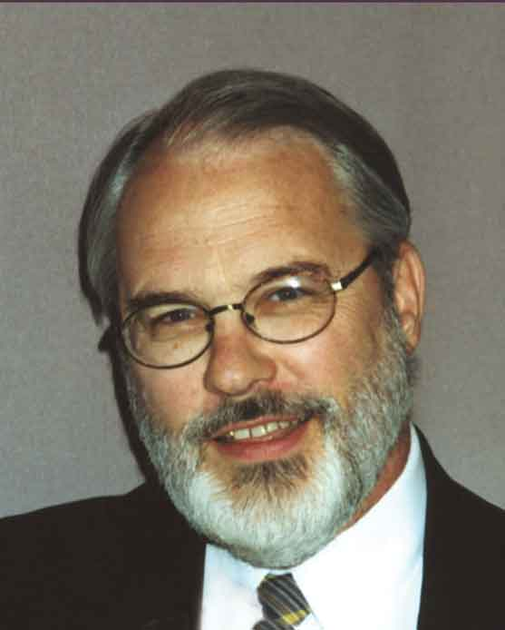

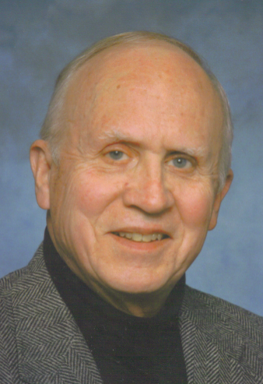
History of NFP
1876 - Mary Putnam Jacobi proves a relationship exists between menstrual cycles and fluctuations in body temperature, blood pressure, and pulse.
1930 – Kyusaku Ogino (Japan) Formulated calculations for determining the infertile phase based on a record of 6 to 12 menstrual cycles giving birth to the calendar rhythm method.
1940 – Jan Holt, M.D. (Dutch) Developed the “temperature rhythm” method.
1951 – Josef Roetzer, M.D. (Austria) Developed the first “sympto-thermal rule” for determining postovulatory infertility.
1964 – John & Lynn Billings, M.D.s (Australia) Published first Ovulation Method using a mucus-only methodology.
1971 – John & Sheila Kippley, Formed the Couple to Couple League promoting a sympto-thermal method and breastfeeding.
1974 – Phoenix NFP Founded
1979 – Thomas Hilgers, M.D. Developed the Creighton Model of the Ovulation Method, based exclusively on the tissue exam for mucus.
1985– NaPro Technology Developed by Dr. Thomas Hilgers at the Pope Paul VI Institute for the Study of Human Reproduction, which he founded in Omaha, Nebraska in 1985.
Notes:
This slide does not loop. If you want the slide to loop, back up one slide and press the “play button” on the bottom right corner of the slide.
Mary Putnam Jacobi was one of the first American woman physicians.
In 1877, she published her findings regarding how a woman’s temperature changes during the cycle
Since then, many other contributions and developments have been made by various doctors over the decades to give us the scientific, effective method of NFP that we have today.
Phoenix NFP Established in 1974 by Phoenix OB/GYN. Became a part of the Diocese of Phoenix on July 1, 2008.
NFP used by couples of all religious, socio-economic backgrounds
All Diocese of Phoenix NFP Instructors are volunteers who are trained in rigorous program in their particular method of NFP.

Slide 28








What is NFP?
Notes:
How many are familiar with NFP?
What have you heard about it?
Natural Family Planning is a method of fertility awareness in which an understanding of the natural cycles of fertility and infertility are taught. A couple who has learned this can then use that information responsibly deciding to either avoid pregnancy by abstaining from genital sexual activity during the fertile time or try to achieve pregnancy by engaging in sexual intercourse when fertile.
NFP is not Rhythm! Rhythm was used before a more scientific and better understanding of women’s fertility was known. Calculations were made by examining a woman’s history while NFP evaluates a current day by day fertility pattern. While it was a precursor of NFP it is not what we are now discussing.

Slide 29



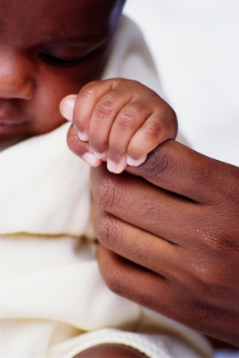
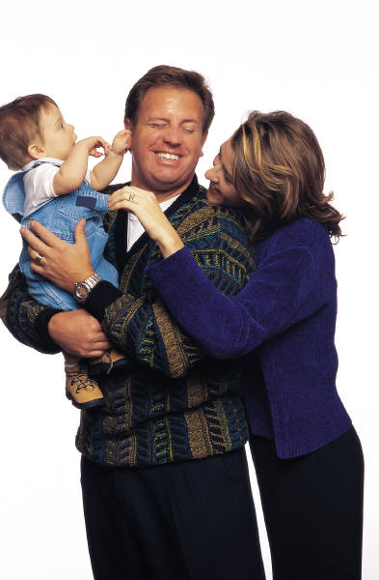

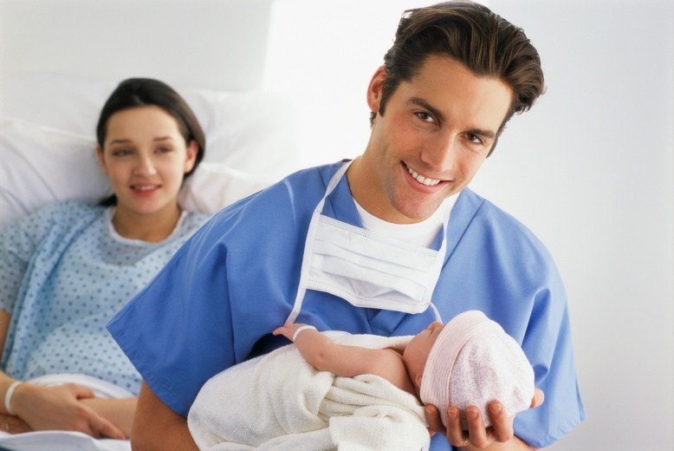
Achieving Pregnancy
Notes:
Couples practicing NFP to achieve pregnancy have the opportunity to discover the awesome gift they possess in becoming co-creators with God as a new life is produced resulting from their union on known fertile days.
They can more accurately calculate their baby’s due date since the approximate time of conception is known. They have a better opportunity to protect their baby’s healthy development due to an earlier confirmation that pregnancy has occurred and they can enjoy the benefits of sharing as a couple the decisions related to planning their family.

Slide 30

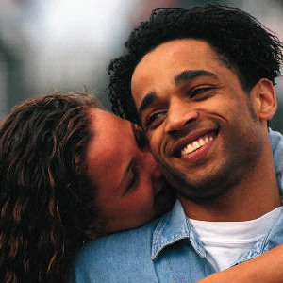

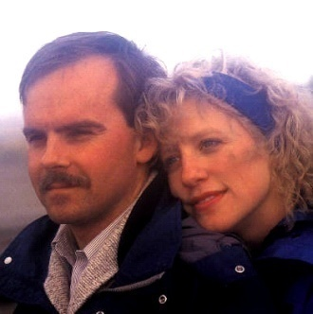
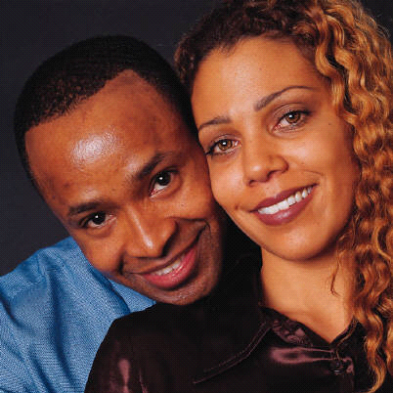
Who Can Use NFP?
Breastfeeding
Regular / Irregular
Menstrual Cycles
Achieving / Avoiding
Pregnancy
Pre-menopause
Post-hormone
Notes:
Natural Family Planning can be used by couples everywhere, in any stage of their reproductive life. You need not have regular cycles and it is applicable while breastfeeding when ovulation might be temporarily delayed as well as during the pre-menopausal time when cycles often change dramatically. Through daily monitoring of signs of fertility, couples evaluate whether or not conception could occur each day. NFP is not limited to just Catholic couples even though its use conforms to Catholic teaching. Women wishing to promote good personal health will tend to look to a method of family planning that has no side effects while allowing them to accomplish their goals. NFP is also inexpensive. After the initial costs of learning there are no other expenses other than for supplies such as thermometers, charts etc.

Slide 31





NFP works by…
Understanding Fertility
Observing Signs
Keeping Charts
Making Couple Decision
Abstaining / Engaging
Notes:
Understanding basic male & female fertility( knowing when you are fertile and when you are not
Observation of fertility signs in a woman’s body
Daily recording signs on chart
Deciding, as a couple to achieve or avoid pregnancy
Abstaining from, or engaging in, marital relations depending on your family planning intentions that cycle.

Slide 32

Develop Fertility Awareness
Notes:
Fertility Awareness is the key to NFP. Through a series of classes and one-to-one follow-up guidance, couples are taught to monitor and chart signs of fertility. From those charts they can determine which rules they should apply depending on their pregnancy intentions.
Next we will be discussing anatomy and physiology:
To understand how and why NFP works it is necessary to understand male and female reproductive anatomy and physiology.

Slide 33
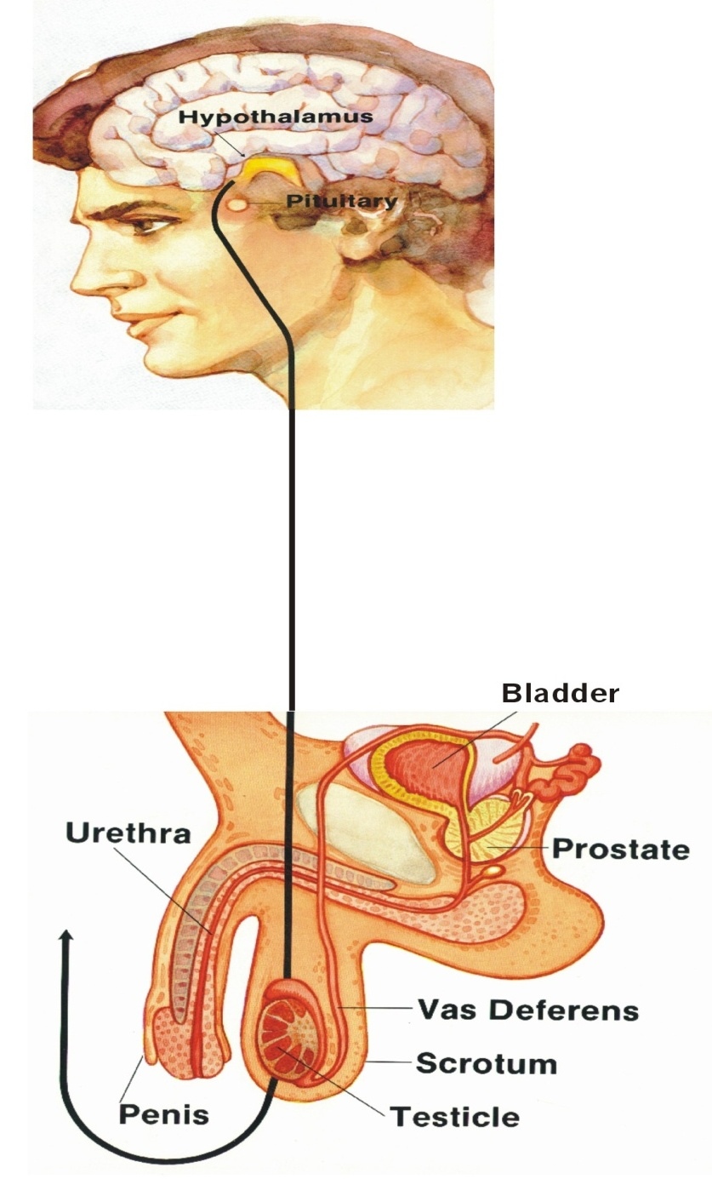
Male Reproductive System
Seminal Vesicles
Notes:
Male Anatomy
Identify: Penis, Testes, Epididymis, Vas Deferens, Urethra, Seminal Vesicles, Bladder and Prostate Gland
The Male is always fertile
Genital contact can lead to pregnancy due to pre-ejaculatory secretions
It is often said that the brain is the primary sex organ. This statement helps us to think of the hormonal processes that direct both male and female fertility. Hormonal messengers are sent from the pituitary gland, in the brain, to the testes or testicles inside the scrotum, a baggy pouch of skin resting under the penis. The primary reproductive organs of the male are located outside the body’s torso so that sperm, which are very sensitive to heat, can be kept a little cooler than normal body temperature. The testicles are about the same shape and size as a plum and they have a twofold function: first, to produce sperm and secondly, to secrete male sex hormones. The most commonly known male sex hormone is testosterone, which is responsible for triggering puberty that results in the growth of body hair, a changing voice and development of body mass.
Healthy males will produce sperm continuously from puberty until they die.
1.) Therefore, it is important to remember that a healthy male from the onset of puberty is always fertile.
After sperm are produced in the testicles, they pass into the epididymus to mature and are expelled through the vas deferens (or sperm duct) and the urethra during ejaculation as part of the semen. The seminal vesicles add to the fluid portion of the semen. The urethra allows either the elimination of urine from the bladder or the ejaculation of semen. A complicated system of valves, within the prostate gland, makes it impossible for both to take place at the same time. In addition, during arousal, the prostate gland changes shape and allows a pre-ejaculatory secretion to take place in order to balance the acidity of the urethra. Present in this fluid are viable sperm. 2) So, if there is any contact between the penis and the vagina during this period of arousal, before ejaculation, enough sperm may be transmitted to cause a pregnancy. This explains why withdrawal, as a form of contraception is often ineffective.

Slide 34
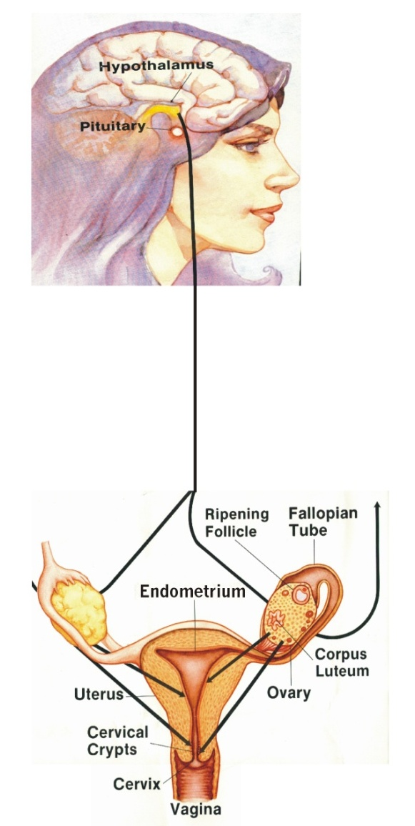
Female Reproductive System
Notes:
Female Anatomy
Identify: Ovaries, Ovum(Egg), Fallopian Tubes, Uterus, Endometrium, Cervix, Cervical Crypts, Vagina
Like men, women’s fertility is also orchestrated from the pituitary gland. But, unlike men, women’s reproductive organs are inside her body. The ovaries, which are about the size and shape of an almond, contain, at her birth, all the eggs a woman will ever have as opposed to sperm production which is continuous. The fallopian tubes are trumpet-shaped organs which form a connecting link to the uterus and it is in the outer third of the fallopian tubes where conception takes place.
At the ends of the fallopian tubes are the fimbria, which are fingerlike projections, which catch and transport the egg toward the uterus after ovulation takes place. The uterus or womb is a muscular organ, similar to a small pear in shape and size, connected to the fallopian tubes and is located in the lower abdomen between the bladder and the rectum. It is very elastic and can greatly expands during pregnancy to accommodate the baby.
The inner lining of the uterus is called the endometrium. Its purpose is to receive and nourish the fertilized egg until birth. If fertilization (the meeting of the sperm and egg) does not occur, this lining degenerates and is eliminated as part of the menstrual flow.
The bottom part of the uterus is the cervix that connects the uterus and vagina. The cervical crypts produce various types of cervical mucus depending on what stage of fertility is present and this is observed by women who use NFP. The vagina, a muscular tube connects the cervix to the external genital structures as well as serving as receptacle for the penis in intercourse, the birth canal and the channel for cervical mucus and menstruation.

Slide 35
Conception
Notes:
Conception - Beginning of Life
We see here the process leading toward conception. When intercourse takes place during the fertile time, the cervical mucus present in the vagina helps to transport the sperm upward into the cervix and the Fallopian Tubes. Conception, the fertilization of the egg by sperm, occurs here, in the upper third of the Fallopian Tube and requires three things:
viable sperm in the Fallopian tube
favorable mucus to allow the sperm to get there
an egg released within the last 24 hours
At conception a unique human individual or embryo forms from the intertwining of DNA molecular strands from the sperm and ovum. At this point the DNA is active and begins a rapid process of organizing nutrition, cell division and differentiation of different types of cells. Indeed, after the first twenty cell divisions, there are thousands of cells.

Slide 36
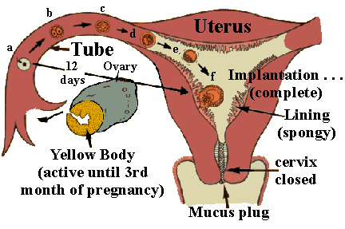
Start of Implantation
c
b
Uterus
d
a
Tube
e
Ovary
12
days
f
Implantation (complete)
Lining
(Spongy)
Yellow Body
(Active until 3rd month
of pregnancy)
Cervix
Closed
Mucus Plug
Notes:
Tiny hairs on the inside of the Fallopian tube, called cilia, move the embryo toward the uterus, a journey that takes approximately 7-10 days. There the embryo implants in the endometrium. The embryo is not just a mass of cells, but a highly diversified individual human being. Three different types of cells , ectoderm, mesoderm and endoderm are already functioning in ways that will form all the systems of the human body.
Note: The “Yellow Body”, or corpus luteum, the former housing for the egg, actively produces a hormone which:
Impacts a change in fertile signs signaling ovulation as passed,
Continues support of the uterine lining if pregnancy has occurred and
Suppresses further ovulation until the birth of the child.
The cervical mucus has formed a plug at the mouth of the cervix to protect a new pregnancy, if it has been achieved, by preventing additional sperm or bacteria from entering the uterus.

Slide 37
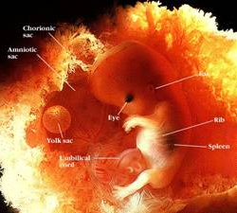
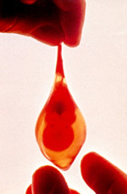
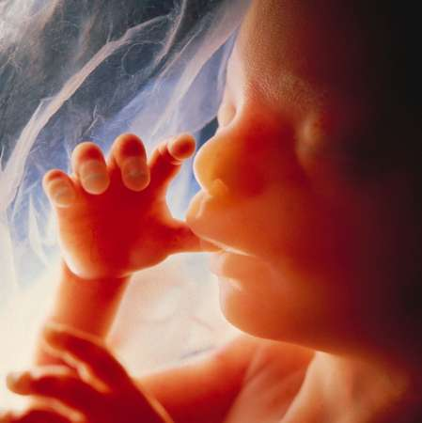
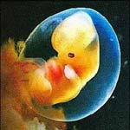
12 weeks
6 weeks
Chorionic
sac
Amniotic
sac
Ear
Eye
Rib
Yolk sac
Spleen
Umbilical
cord
24 weeks
5 weeks
Notes:
**Dr. Bernard Nathensen—saw a tubal pregnancy baby like this one at 6 weeks, alive and stopped aborting babies.
At 8 weeks of fetal development this child is just about 1” long. Everything is present that will allow full adult development. The heart has been beating for about a month, the stomach is producing digestive juices and the kidneys are functioning. Many sets of muscles receive nerve stimulation. This baby responds to its mother’s touch even though she cannot yet feel her child’s movement.
Hormonal Influence on the Menstrual Cycle
In these next series of slides we will be taking you through a woman’s reproductive system through one entire menstrual cycle so you can see how highly organized it is.

Slide 38
Notes:
Imagine the menstrual cycle as a horizontal line, beginning on the left with menstruation and ending on the right with the next menstruation. Ovulation ( or the release of the egg) is shown on this example as occurring at the vertical midline, on one of these green days.
Let’s begin in a woman’s ovaries. Hormones are chemical “messengers” which are produced in one part or organ of the body and initiate or regulate the activity of an organ or group of cells in another part of the body
As FSH (Follicle Stimulating Hormone) is released from the brain, many follicles respond in the ovary and begin to mature, releasing estrogen into the bloodstream. When a desired level of estrogen from the developing follicles has reached the brain it is stimulated to release another hormone, LH (Lutienizing hormone) which triggers the actual event of ovulation of the dominant egg. The remaining developing eggs atrophy and no additional follicles begin to develop until the next cycle. Once the egg is released from the ovary, the follicle (or yellow body known as the corpus luteum) that held the egg, changes in function, and now produces increased levels of progesterone. The levels of progesterone and estrogen remain for about 10-16 days at which time they sharply decline if pregnancy has not occurred. What event do you think this will trigger in the woman’s body? Yes, menstruation!

Slide 39
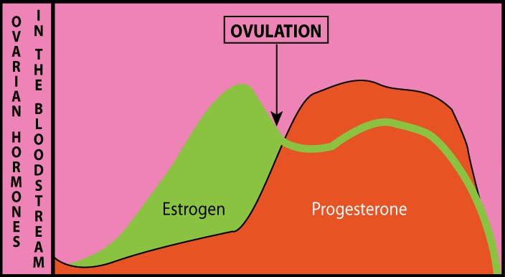
Notes:
This slide shows the rise of estrogen levels in the early part of the cycle and the elevation of progesterone is the later part of the cycle. The following slides will demonstrate how estrogen and progesterone affect the fertility signs of a woman.

Slide 40
Notes:
In the early part of the cycle, without hormonal influence, the cervix when examined by the woman is low, firm, closed and no mucus is present.
As the follicle in the ovary develops and estrogen is released, the cervix changes to a high position, becoming softer, and more open to allow the passage of sperm. Simultaneously mucus from the cervical crypts begins to flow.
Observation of this mucus and its changing pattern is a fertility sign noted along with the changes in the cervix itself. Once ovulation has passed, the progesterone produced by the corpus luteum in the ovary causes the cervix to return to a low, firm, closed position and the mucus dries up and forms a plug to protect a the baby if pregnancy should have begun in this cycle.

Slide 41
Notes:
This picture is of a cross section of the endometrium or uterine lining. During menstruation, the superficial layer of the endometrium is shed; however, estrogen causes new growth to occur, so that by the time of ovulation, the thickness of the endometrium has quadrupled. After ovulation, under the influence of progesterone, the endometrium continues to grow and becomes soft and spongy as it prepares to receive a child in the event of pregnancy. If pregnancy hasn’t occurred, the sharp decline of hormones causes the endometrium to be sloughed off, in about 2 weeks, as part of the following menstrual flow.

Slide 42
Notes:
The woman’s waking temperature, undisturbed by activity, is known as the Basal Body Temperature and can be taken daily each morning and charted. Under normal conditions and following a good night’s rest it is the lowest temperature she will experience daily.
It is one of the signs checked in the Symptom-Thermal method of NFP.
After ovulation, the corpus luteum produces a level of progesterone, the hormone which will affect the temperature regulating system in the brain, and a woman will see a rise in her temperature. If she is not pregnant her temperature will drop toward the end of her cycle due to a rapid decrease in her progesterone and estrogen levels.
If she is pregnant the temperature will stay elevated through much of her pregnancy and in fact a sustained high temperature phase of 18-21 high temperatures will be an early sign of pregnancy.
Taking the temperature and seeing a sufficient and sustained rise confirms that ovulation has taken place in a cycle and will also inform a woman if she has not yet ovulated if a temperature rise has not yet occurred.
What does this sound like? An incubator has increased temperature to help babies. It is something like that.

Slide 43
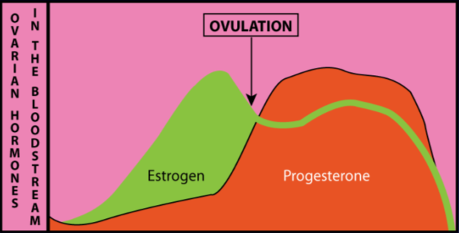
“You formed my inmost being; you knit me in my mother’s womb.”
“I praise you, so wonderfully you made me; wonderful are your works!”
Psalm 139:13-14
Notes:
As you can see when all the elements are combined on one slide, the menstrual cycle does not unfold haphazardly, but can be likened to an elaborate symphony. It follows a highly organized pattern and there is a sophisticated “feedback” system between the ovaries and the pituitary gland in the brain. Each of the observations shown here is the result of the hormone stimulation and all of these events occur in each normal cycle until menopause.
It is pretty amazing to see how wonderfully each woman is created and how in each cycle, a woman’s body is gearing up to prepare for conception to occur and that after ovulation, the body responds by preparing for a possible pregnancy. Even the name of the hormone responsible for many of the changes after ovulation tells us what a woman’s body is working for. Progesterone (pro-gestation) means favoring life. It’s what a woman’s body naturally does each and every menstrual cycle.
When a couple decides on a hormonal contraceptive, then the high levels of synthetic hormones that are needed to disrupt this natural cycle also have systemic effects in other areas of the body. The woman’s natural system works beautifully. The pill, chemical laced IUD, shot, patch etc… are powerful drugs used to disrupt a working system. (Medical intervention is usually needed to fix something broken or heal an illness, but when a women’s body ovulates and prepares to nourish new life it is not broken or ill and doesn’t need medical intervention.)

Slide 44
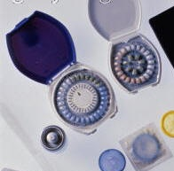
NFP is not Contraceptive
Notes:
NFP is not contraceptive. Contraceptives are mechanical, chemical or surgical means to prevent pregnancy, and in some cases, are actually abortifacients-meaning that they work to prevent the continuation of an early pregnancy that has already occurred. While NFP may have the same ends, or results as birth control, in the limiting of family size, no action is taken to withhold, suppress, alter or destroy either the man or woman’s reproductive function. Couples using NFP make the free choice not to engage in sexual relations when fertile if they do not intend to invite God to create a new life in that cycle.
So, even though the ends might be the same, the means are very different. (Ex. Stealing or working to buy food for your kids are different means to the same ends, but not morally equivalent…etc).

Slide 45
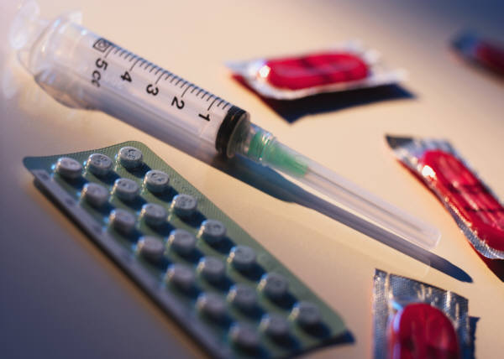
Types of Contraception
Barriers
Chemicals
Devices
Withdrawal
Notes:
At this point we will examine how contraceptives work.
Barriers: Condoms, diaphragms, cervical caps, vaginal sponges, and spermicides.
Action: designed to physically or chemically prevent the union of a sperm & an egg. All of these barriers require a couple to gear up to “ protect” themselves from the other’s fertility, rather than to unite completely in an act that should be a complete self-donation through marital intercourse. Side effects range from allergies to bladder infections and the effectiveness of the methods is rather low.
Chemicals ( synthetic hormones): Birth Control Pills (OCPs), Injectables or “shots” such as Lunelle or Depo-Provera, transdermals such as the Patch, Vaginal Rings, Emergency Contraception( Morning After Pill) and subdermal implants such Norplant (no longer being inserted).
All are both contraceptive and abortifacient in their methods of action.
Action:
Inhibition of ovulation
Changes in the cervical mucus to make it thicken (which increases the difficulty of sperm entry into the cervix)
Tubal motility is changed, affecting the sperm and egg movement through the Fallopian tubes.
Depletion of the endometrium which reduces the likelihood of implantation of a blastocyst, causing an early abortion.
It is known that even though using these contraceptives, breakthrough
ovulation is known to occur approximately 2-8% of the time
and therefore pregnancy is possible. If pregnancy does occur, the newly
conceived life is unable to implant in the uterus due to the
chemically induced changes. These chemicals therefore have the
potential to be abortifacient, or causing an early abortion, happening
before a woman even realizes she is pregnant.
*( Bronson, RA. “ Oral Contraception: mechanism of action.” Clinical Obstetrics and Gynecology, 1981.; Killick, Fitzgerald, American Journal Obstetrics and Gynecology 1998)
Side Effects: In addition to this little-known potential abortifacient effect, using these chemicals disrupts a normally functioning reproductive system occurring in the woman’s body. They also produce many side effects ranging from mild to severe and are too numerous to list, but range from menstrual difficulties to bone density loss, cancers, tumors, heart disease, and depression.
Important to note: There is a definite link that has been shown to the later development of breast cancer. In fact, the results of a 2006 Mayo Clinic investigation show an over-all 19% increased risk for premenopausal breast cancers in women who used birth control pills. Among women who had children the risk increases to 29% and for those women who began pill use prior to their first full term pregnancy the risk jumps to 44 %.
(Full study: www.mayoclinicproceedings.com/pdf/8110/8110a1.pdf) In addition, since 2005, the World Health Organization classifies oral contraceptives as “ highly carcinogenic.”)
Devices: IUDs, Vaginal Rings( also a chemical form of contraceptive)
Actions:
IUDs – polyethylene or copper objects inserted into the uterus. Some have a silicone tube containing hormones and some have copper both designed to interfere with fertilization through impact on sperm motility or changes in the cervical mucus. They do not inhibit ovulation. These devices are therefore considered potentially abortifacient because they act mechanically to prevent a pregnancy, should it occur, from implanting in the uterus where it must live and grow to survive.
They can also cause ectopic pregnancies, increased menstrual bleeding, increased risk of Pelvic Inflammatory Disease, which can lead to infertility.
Vaginal Rings –are rings made of a synthetic material containing chemicals and inserted into the vagina. The intended action is to prevent ovulation as well as increase the difficulty of sperm motility and promote change in the endometrium reducing the likelihood of implantation should a pregnancy occur.
Thus, they also have the same potential of acting as abortifacients and the same risks associated with the pill.
Please make sure you double check these assertions. A good source: PDR – Physicians’ Desk Reference – www.PDR.net)
Withdrawal
Withdrawal as a means of contraception is regarded as having a low effectiveness rate and is not considered a moral practice as it separates the unitive and procreative elements when ejaculation intentionally takes place outside the vagina.
Please refer to the brochure “The Family Planning Decision” which you have received in your folder for other information about the mild to severe side-effects, cost and general information about contraceptives.
Other means which are not contraceptive but act to prevent or terminate the life of a child include:
Sterilization: defined as surgical intervention which inhibits normal reproductive function. It can be reversed but is quite expensive and is often unsuccessful. You can get further information regarding this in the brochures given in your folders.
Both contraception and sterilization regard the gift of fertility as something to be disposed of, treated as a disease or obliterated.
Abortion is defined as the willful termination of a pregnancy. This is accomplished chemically by drugs such as RU 486 or surgically through abortion.
Emergency Contraception or “the Morning after Pill” which is an extremely high dose of the birth control pill and is now available without prescription for 17 year olds! (Preven EC) has three actions:
1. Prevention of ovulation (if it has not yet occurred)
2. Disruption of fertilization (joining of the sperm and egg)
3. Inhibition of implantation (attachment of a fertilized egg to the uterus)
It therefore also has abortifacient potential.

Slide 46
What’s The Difference?
Natural Family Planning
Relational Differences
Encourages shared responsibility
Enhances couple communication
Abstain from sex if avoiding pregnancy
Fosters mutual respect
Acknowledges that sexual intercourse may result in pregnancy
Promotes growth/longevity of marriage
Contraception
Relational Differences
Is primarily an individual responsibility
Lessens need for discussion
Engage in sex while avoiding pregnancy
Creates environment to “use” partner
Mentally and physically separates connection between sex and pregnancy
May result in promiscuity, infidelity and divorce
Natural Family Planning
Moral Differences
Unitive & procreative elements present
Conscious choice to engage in or avoid sexual intercourse during fertile times
Promotes viewing fertility as a gift
Promotes idea of “children as gift”
Promotes self mastery, maturity, generosity
Fosters acceptance to new life and unplanned pregnancy
Fosters responsible sexual behavior
Contraception
Moral Differences
Unitive and/or procreative elements absent
Often unaware if fertile or infertile which necessitates continuous contraception
Treats fertility as a disease
Encourages attitude of “children as burden”
Promotes selfishness, immaturity
May resort to abortion if pregnancy occurs
Pill, Patches, Implants, Rings, Injectables, and IUD, act as abortifacients
Enables irresponsible sexual behavior
Natural Family Planning
Effectiveness Rates
Sympto-Thermal and Ovulation methods have up to 99% effectiveness rate if properly learned and used according to instructions for avoiding or delaying pregnancy.
Contraception
Effectiveness Rates
Pill, patch, rings = 92%
Injectables = 97%
IUD = 98-99%
Diaphragm = 84%
Cervical Cap = 68-84%
Condoms = Male-85%, Females-79%
Spermicides-71%
Withdrawal 73%
Surgical Sterilization = 99%
Natural Family Planning
Medical Differences
No health risks to woman from use
Harmless to child if conception occurs while using
Works with fertility cycles and for all women in any phase of reproductive life
No impact on future fertility
Contraception
Medical Differences
Possible physical side effects to woman from use
May lead to early abortion if child is conceived while using
Suppresses or eliminates fertility
May impact future fertility
Notes:
A question we re-visit now: “If the end is the same (the end being the spacing or limiting the number of children in our family) then what is the difference between using Natural Family Planning, contraception or perhaps even sterilization?
We’d like to give you some differences: Go over the main ones on the following slides and let them know there is a more complete sheet in their introduction packet. (Blue)

Slide 47
What’s The Difference?
Natural Family Planning
Relational Differences
Encourages shared responsibility
Enhances couple communication
Abstain from sex if avoiding pregnancy
Fosters mutual respect
Acknowledges that sexual intercourse may result in pregnancy
Promotes growth/longevity of marriage
Contraception
Relational Differences
Is primarily an individual responsibility
Lessens need for discussion
Engage in sex while avoiding pregnancy
Creates environment to “use” partner
Mentally and physically separates connection between sex and pregnancy
May result in promiscuity, infidelity and divorce
Natural Family Planning
Moral Differences
Unitive & procreative elements present
Conscious choice to engage in or avoid sexual intercourse during fertile times
Promotes viewing fertility as a gift
Promotes idea of “children as gift”
Promotes self mastery, maturity, generosity
Fosters acceptance to new life and unplanned pregnancy
Fosters responsible sexual behavior
Contraception
Moral Differences
Unitive and/or procreative elements absent
Often unaware if fertile or infertile which necessitates continuous contraception
Treats fertility as a disease
Encourages attitude of “children as burden”
May promote selfishness & immaturity
May resort to abortion if pregnancy occurs
Pill, Patches, Implants, Rings, Injectables, and IUD, act as abortifacients
Enables irresponsible sexual behavior
Natural Family Planning
Effectiveness Rates
Sympto-Thermal and Ovulation methods have up to 99% effectiveness rate if properly learned and used according to instructions for avoiding or delaying pregnancy.
Contraception
Effectiveness Rates
Pill, patch, rings = 92%
Injectables = 97%
IUD = 98-99%
Diaphragm = 84%
Cervical Cap = 68-84%
Condoms = Male-85%, Females-79%
Spermicides-71%
Withdrawal 73%
Surgical Sterilization = 99%
Natural Family Planning
Medical Differences
No health risks to woman from use
Harmless to child if conception occurs while using
Works with fertility cycles and for all women in any phase of reproductive life
No impact on future fertility
Contraception
Medical Differences
Possible physical side effects to woman from use
May lead to early abortion if child is conceived while using
Suppresses or eliminates fertility
May impact future fertility
Notes:
A question we re-visit now: “If the end is the same (the end being the spacing or limiting the number of children in our family) then what is the difference between using Natural Family Planning, contraception or perhaps even sterilization?
We’d like to give you some differences: Go over the main ones on the following slides and let them know there is a more complete sheet in their introduction packet. (Blue)

Slide 48
What’s The Difference?
Natural Family Planning
Relational Differences
Encourages shared responsibility
Enhances couple communication
Abstain from sex if avoiding pregnancy
Fosters mutual respect
Acknowledges that sexual intercourse may result in pregnancy
Promotes growth/longevity of marriage
Contraception
Relational Differences
Is primarily an individual responsibility
Lessens need for discussion
Engage in sex while avoiding pregnancy
Creates environment to “use” partner
Mentally and physically separates connection between sex and pregnancy
May result in promiscuity, infidelity and divorce
Natural Family Planning
Moral Differences
Unitive & procreative elements present
Conscious choice to engage in or avoid sexual intercourse during fertile times
Promotes viewing fertility as a gift
Promotes idea of “children as gift”
Promotes self mastery, maturity, generosity
Fosters acceptance to new life and unplanned pregnancy
Fosters responsible sexual behavior
Contraception
Moral Differences
Unitive and/or procreative elements absent
Often unaware if fertile or infertile which necessitates continuous contraception
Treats fertility as a disease
Encourages attitude of “children as burden”
Promotes selfishness, immaturity
May resort to abortion if pregnancy occurs
Pill, Patches, Implants, Rings, Injectables, and IUD, act as abortifacients
Enables irresponsible sexual behavior
Natural Family Planning
Effectiveness Rates
Sympto-Thermal and Ovulation methods have up to 99% effectiveness rate if properly learned and used according to instructions for avoiding or delaying pregnancy.
Contraception
Effectiveness Rates
Pill, patch, rings = 92%
Injectables = 97%
IUD = 98-99%
Diaphragm = 84%
Cervical Cap = 68-84%
Condoms = Male-85%, Females-79%
Spermicides-71%
Withdrawal 73%
Surgical Sterilization = 99%
Natural Family Planning
Medical Differences
No health risks to woman from use
Harmless to child if conception occurs while using
Works with fertility cycles and for all women in any phase of reproductive life
No impact on future fertility
No environmental impact of NFP
Contraception
Medical Differences
Possible physical side effects to woman from use
May lead to early abortion if child is conceived while using
Suppresses or eliminates fertility
May impact future fertility
Significant levels of artificial hormones found in waterways from oral contraceptive usage
Notes:
A question we re-visit now: “If the end is the same (the end being the spacing or limiting the number of children in our family) then what is the difference between using Natural Family Planning, contraception or perhaps even sterilization?
We’d like to give you some differences: Go over the main ones on the following slides and let them know there is a more complete sheet in their introduction packet. (Blue)

Slide 49
What’s The Difference?
Natural Family Planning
Relational Differences
Encourages shared responsibility
Enhances couple communication
Abstain from sex if avoiding pregnancy
Fosters mutual respect
Acknowledges that sexual intercourse may result in pregnancy
Promotes growth/longevity of marriage
Contraception
Relational Differences
Is primarily an individual responsibility
Lessens need for discussion
Engage in sex while avoiding pregnancy
Creates environment to “use” partner
Mentally and physically separates connection between sex and pregnancy
May result in promiscuity, infidelity and divorce
Natural Family Planning
Moral Differences
Unitive & procreative elements present
Conscious choice to engage in or avoid sexual intercourse during fertile times
Promotes viewing fertility as a gift
Promotes idea of “children as gift”
Promotes self mastery, maturity, generosity
Fosters acceptance to new life and unplanned pregnancy
Fosters responsible sexual behavior
Contraception
Moral Differences
Unitive and/or procreative elements absent
Often unaware if fertile or infertile which necessitates continuous contraception
Treats fertility as a disease
Encourages attitude of “children as burden”
Promotes selfishness, immaturity
May resort to abortion if pregnancy occurs
Pill, Patches, Implants, Rings, Injectables, and IUD, act as abortifacients
Enables irresponsible sexual behavior
Natural Family Planning
Effectiveness Rates
Sympto-Thermal and Ovulation methods have up to 99% effectiveness rate if properly learned and used according to instructions for avoiding or delaying pregnancy.
Contraception
Effectiveness Rates
Pill, patch, rings = 92%
Injectables = 97%
IUD = 98-99%
Diaphragm = 84%
Cervical Cap = 68-84%
Condoms = Male-85%, Females-79%
Spermicides-71%
Withdrawal 73%
Surgical Sterilization = 99%
Natural Family Planning
Medical Differences
No health risks to woman from use
Harmless to child if conception occurs while using
Works with fertility cycles and for all women in any phase of reproductive life
No impact on future fertility
Contraception
Medical Differences
Possible physical side effects to woman from use
May lead to early abortion if child is conceived while using
Suppresses or eliminates fertility
May impact future fertility
Notes:
A question we re-visit now: “If the end is the same (the end being the spacing or limiting the number of children in our family) then what is the difference between using Natural Family Planning, contraception or perhaps even sterilization?
We’d like to give you some differences: Go over the main ones on the following slides and let them know there is a more complete sheet in their introduction packet. (Blue)

Slide 50
Methods of NFP available in Diocese of Phoenix
Sympto- Thermal Method : Sympto Pro or CCL
Ovulation Method: BOMA or Family of Americas
Creighton Method-especially helpful for infertility
English and Spanish classes in over 30 locations of Diocese.
Notes:
How Natural Family Planning is Practiced
As seen in the previous explanation of hormonal influence on reproductive function we have looked at the many signs of fertility that are affected. Couples using NFP monitor and chart those signs on a daily basis.
There are two main methods of NFP: The Sympto-Thermal Method and the Ovulation or Mucus-Only Method. We have teachers of both these types of methods in the Diocese of Phoenix, represented by Northwest Family Services, Billings Ovulation Method, Family of the Americas, the Couple to Couple League and Creighton Method. Each method charts their observations somewhat differently but the two main observations are:
Temperature:
In the Sympto-Thermal Methods, women daily take and record their waking temperature and watch for patterns that will tell them when ovulation has passed for each cycle. This information will also confirm if a woman is not ovulating which is useful when difficulty achieving pregnancy occurs. The temperature does not pinpoint the exact day of ovulation nor is it necessary to do so in order to successfully use NFP.
Tissue/Mucus observation:
In all methods of NFP, each time a woman uses the bathroom she is taught to do a tissue examination for the presence of cervical mucus. This mucus, if present, travels down through the vagina and will appear on the tissue when a woman wipes herself. Couples learning NFP are taught to evaluate the appearance and changes of this mucus in order to anticipate when the woman is preparing to release an egg as well as when the time to achieve pregnancy has passed.

Slide 51
Sympto-Thermal Chart
Notes:
These slide show 3 different charts for different NFP methods for records of all signs observed during one cycle. In every NFP method, these charts provide useful information not only about fertility but also about reproductive health.
Please note: While we have described the signs we monitor, we have not taught how to interpret those signs or apply the rules to avoid or achieve pregnancy. In the classes that follow you will be provided you with sufficient information to practice NFP effectively.

Slide 52
Ovulation Method Chart
Notes:
This is a chart for another NFP method that we offer from the Office of NFP, called Billings Method, or Ovulation Method, where the symptom of the temperature is not taken.

Slide 53
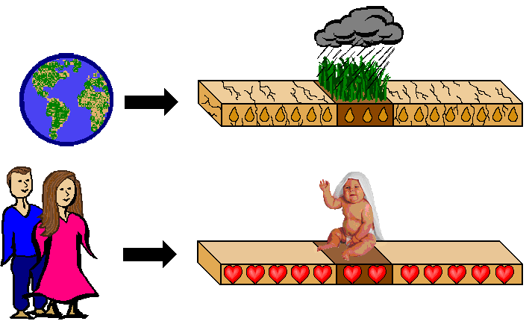



Notes:
While all the methods we teach in our Diocese provide a lot of helpful information in the classes and additional reading to take home, NFP is also taught and used well in countries where literacy is rare and items such as a thermometer would appear “high-tech.” NFP is taught there by relating fertility cycles to that of the earth and its seasons.
When the earth is dry, a seed may be planted but will not develop.
When the rains come and a seed is planted it will grow.
.
This simple concept is easily understood by relating marital relations during a woman’s fertile time to planting seeds in fertile soil nourished by rain. Likewise, intercourse during the infertile time is likened to planting seeds in dry soil.
Blessed Mother Theresa of Calcutta whose work in the slums won her a Nobel Peace Prize says her NFP program which she and team of sisters taught, prevented more than 1.1 million births in an 11 year period. A United Nations team made a two year study to check those results and called its effectiveness, “remarkable.”

Slide 54

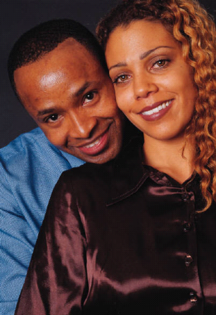


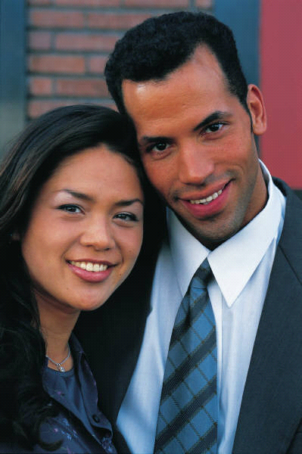
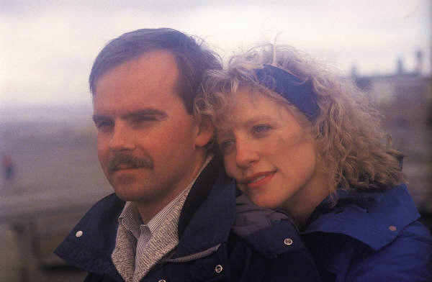




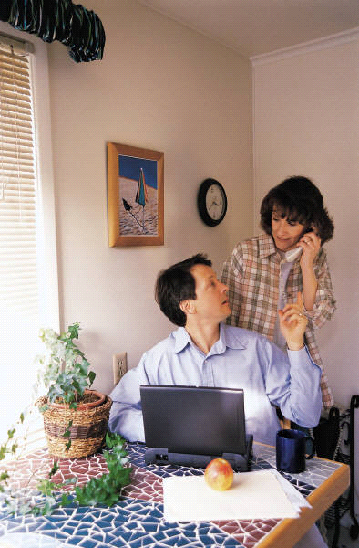

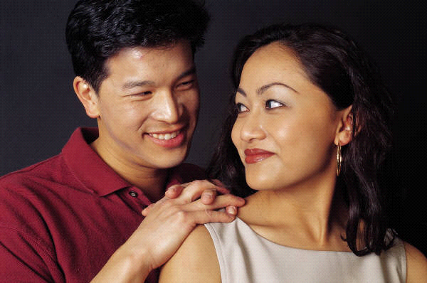
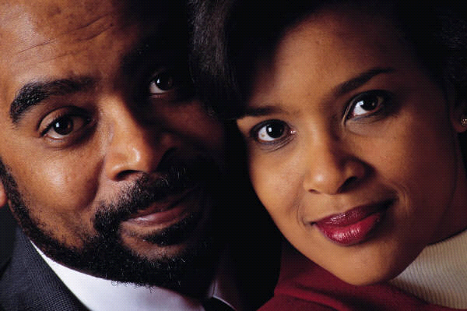
The Effectiveness Of NFP
Depends On
You
Notes:
Scientific studies of women’s menstrual cycles have produced conclusive evidence of NFP’s effectiveness. A recent 2007 study published in the journal Human Reproduction found the effectiveness of the Sympto-Thermal Method was 99.6%, while the most recent figures from a long term study of the Ovulation Method in China yielded a 99.5% effectiveness rate.
We have also provided a brochure A Family Planning Decision in your Introduction packet where you can look at the effectiveness rates from other studies and the sources for those statistics. As you can see, NFP compares quite favorably with the rates quoted for contraceptive use. Affecting those rates for all contraceptives as well as for NFP are factors such as:
Motivation
Understanding of proper use
Following directions
Neither NFP nor contraceptives claim 100% effectiveness to avoid pregnancy.
Qualities Sheet
Refer back to Activity #1
Ask for volunteer examples they have listed. Point out how NFP is a “tool” for learning and continuing to develop these qualities that can be used in all areas of their relationship.

Slide 55
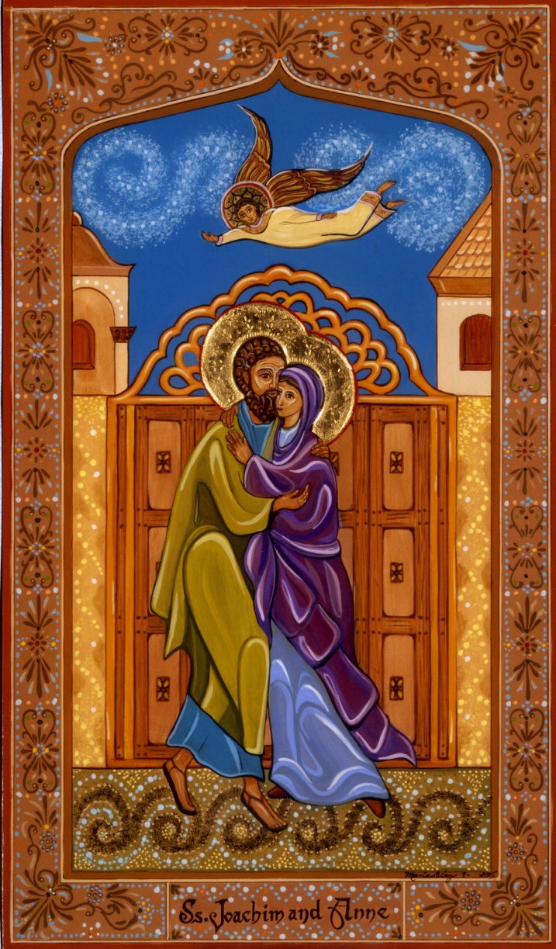
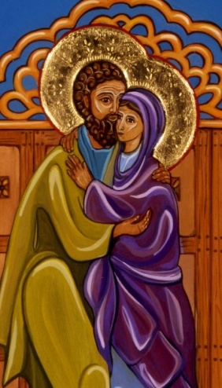

NFP Respects Marital Love
“NFP empowers a couple constantly to be mindful of the ‘community of love’ that the Church calls them to celebrate in their home, and enables them to always see their children – those already born and those yet to be – in their lover’s eyes.”
Dr. Gregory Popcak, “Beyond the Birds and the Bees”, p.187
Notes:
(Couples should take the time to write their talk, which should be 10-15 minutes long. They should practice it with friends, the NFP Office, or with other NFP teaching couples.)
Include:
Your NFP story
Difficulties
How abstinence is handled
Positive effects
Invitation:
In light of today’s discussion we want to issue an invitation to you:
If you are unmarried and have chosen to wait until marriage to become sexually active, we encourage you to continue with this resolution.
If you are unmarried and currently sexually active or even living together, we invite you to discuss this decision in the light of all we covered tonight and resolve now to abstain from sexual activity until your marriage. You may decide to live apart while engaged to give yourself an opportunity to get to know each other in a different way than you have before. You might not be aware of social sciences’ findings that those couples who do marry after living together, on the whole will experience lower marital happiness, increased marital conflict and a greater risk of divorce. We hope you will investigate these findings that cut across all levels of income, education and parent’s marital status, as they are significant.
If you are currently using contraceptives please take time to discuss this with each other and consider discontinuing them for all the reasons we have covered.
Please take 5 min. now, as a couple to discuss this, and continue your discussion after you leave here. We especially recommend listening to Janet Smith’s cd, “Contraception, Why Not”, found in your intro packet on your way home tonight or in the very near future.

Slide 56

NFP Class Series
Classroom
presentations
Course manual
Charting
materials
Lifelong personal consultation and chart review
Cost: $130-$175 per couple/single
Web-based client instruction - $145
Notes:
We have placed this year’s NFP schedule inside the introduction packet. All registrations, except for the Couple to Couple League classes, are done on our website: www.phxnfp.org which is listed on the schedule as well as on the front of your packet.
Closing
Questions/Answers:
Offer opportunity to ask questions as well as offering to be available after class for further discussion
Evaluations and Certificates:
Take a few minutes to look through your introduction packet to see the brochures and articles that we have for you. Please take out and complete your Evaluation Sheet from the Intro Packet and give it to us. You may take a few minutes to do this while we get the certificates ready. When we are ready, please bring the evaluation forms to this table. We will distribute certificates in this manner: For Women whose last name begins with A-L, come to me, and for women, whose last name begins with M-Z, please go to my husband.
Closing Prayer
As we move into our final prayer, we ask you to place the hands of your beloved in yours. Consider the words of Jesus during the most sacred time of the Mass. He says: "This is my body which will be given up for you." It is this great act of generosity which, as Christians, we believe has brought us our salvation. We who are preparing for marriage and those of us already married pray for the grace to show this generous love to our spouses.
The Prayer:
Jesus, you did not withhold your love from us. You became human for our sake. Being born in a family, you made it possible that the love of a family can be totally generous. When you gave us your body in the Eucharist on the night before you died, you showed us how complete love can be in the words: "This is my body, which will be given up for you." Lord, these couples are preparing to give their bodies, their entire selves, to each other. Bless their gift of self by your gift of self. Send your loving spirit to them, so that their lives may be given up for each other. Let this gift be a witness to their children, to their neighbors, to the Church and to the world, which yearns for a love that lasts forever. We ask you this, our loving Savior, who in union with the Father and the Holy Spirit live and reign with you forever and ever.
Amen

Slide 57
Sign Up to Learn!
Part of the Office of Marriage and Respect Life
        www.phxnfp.org
        602-354-2122
Notes:
This concludes the presentation.
Thank you.

