Slide 1
Incarnational Dynamism
Diocese of Phoenix

Slide 2
John 1
In the beginning was the Word, and the Word was with God, and the Word was God.
He was in the beginning with God.
All things came to be through him, and without him nothing came to be.
What came to be through him was life, and this life was the light of the human race; darkness has not overcome it.
John 1:1-4

Slide 3
1 John 1
What was from the beginning, what we have heard, what we have seen with our eyes, what we looked upon and touched with our hands concerns the Word of life--
For the life was made visible; we have seen it and testify to it and proclaim to you the eternal life that was with the Father and was made visible to us--
What we have seen and heard we proclaim now to you, so that you too may have fellowship with us; for our fellowship is with the Father and with his Son, Jesus Christ.
We are writing this so that our joy may be complete.
1John 1:1-4

Slide 4
George Weigel Letters to a Young Catholic
When the Christian movement largely displaced the gods of Greek and Roman antiquity, everyone, whether Christian or not, might well have imagined that this meant the death of religious art. Mainstream Christianity accepted the Hebrew Bible as divine revelation, and that meant… ‘Thou shalt not make unto thee any graven image.’

Slide 5
Had they won the day, religious art would have been doomed.
When Christianity met the neo-platonic thought that dominated the Mediterranean world, some Christian philosophers began to teach that the image of God in us, and preeminently in Christ, is located in the rational soul – and you can’t paint or sculpt or make mosaic representation of the rational soul. For these thinkers, attempts to portray the “image of God” in us was both idolatrous and philosophically absurd.

Slide 6
What happened?
Yet the triumph of Christianity in the Roman world actually produced an extraordinary and unprecedented outpouring of artistic creativity that continues to this day. What happened?

Slide 7
The Word Became Flesh
The grittiest, most earthy of Christian claims – that the Son of God became flesh in Jesus of Nazareth – eventually became the rationale for both Christian iconography and Christian representational art. Rather than negate art, the Incarnation became the ultimate warrant for religious art.

Slide 8
Those who are learned will be radiant as the sky in all its beauty; those who instruct the people in goodness will shine like the stars for all eternity.
Antiphon, St. Peter Damian

Slide 9
457 The Word became flesh for us in order to save us by reconciling us with God, who "loved us and sent his Son to be the expiation for our sins": "the Father has sent his Son as the Savior of the world", and "he was revealed to take away sins":⁷⁰

Slide 10
458 The Word became flesh so that thus we might know God's love: "In this the love of God was made manifest among us, that God sent his only Son into the world, so that we might live through him."⁷² "For God so loved the world that he gave his only Son, that whoever believes in him should not perish but have eternal life."⁷³

Slide 11
459 The Word became flesh to be our model of holiness: "Take my yoke upon you, and learn from me." "I am the way, and the truth, and the life; no one comes to the Father, but by me."⁷⁴ On the mountain of the Transfiguration, the Father commands: "Listen to him!"⁷⁵ Jesus is the model for the Beatitudes and the norm of the new law: "Love one another as I have loved you."⁷⁶ This love implies an effective offering of oneself, after his example.⁷⁷

Slide 12
460 The Word became flesh to make us "partakers of the divine nature":⁷⁸ "For this is why the Word became man, and the Son of God became the Son of man: so that man, by entering into communion with the Word and thus receiving divine sonship, might become a son of God."⁷⁹ "For the Son of God became man so that we might become God."⁸⁰ "The only-begotten Son of God, wanting to make us sharers in his divinity, assumed our nature, so that he, made man, might make men gods."⁸¹

Slide 13
Recapitulation
518 Christ's whole life is a mystery of recapitulation. All Jesus did, said and suffered had for its aim restoring fallen man to his original vocation: When Christ became incarnate and was made man, he recapitulated in himself the long history of mankind and procured for us a "short cut" to salvation, so that what we had lost in Adam, that is, being in the image and likeness of God, we might recover in Christ Jesus.¹⁸⁵ For this reason Christ experienced all the stages of life, thereby giving communion with God to all men. St. Irenaeus, Against the Heresies

Slide 14
There is beauty when the essence of a thing shines clearly through its outward appearance: beauty is the gleaming of the substantial or actual form that is found in the proportional parts of a material thing.
St. Albert (not the Great) (Saward 44)

Slide 15
Religious Dimension of Education in a Catholic School
61. Literary and artistic works depict the struggles of societies, of families, and of individuals. They spring from the depths of the human heart, revealing its lights and its shadows, its hope and its despair. The Christian perspective goes beyond the merely human, and offers more penetrating criteria for understanding the human struggle and the mysteries of the human spirit. Furthermore, an adequate religious formation has been the starting point for the vocation of a number of Christian artists and art critics.

Slide 16
…In the upper grades, a teacher can bring students to an even more profound appreciation of artistic works: as a reflection of the divine beauty in tangible form. Both the Fathers of the Church and the masters of Christian philosophy teach this in their writings on aesthetics-St. Augustine invites us to go beyond the intention of the artists in order to find the eternal order of God in the work of art; St. Thomas sees the presence of the Divine Word in art.

Slide 17
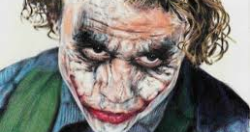
Ugliness
The devil can and does abuse beauty in order to entice men into worship of self and the rejection of God. He incites to lust through the beauty of the body, or to pride through beauty of the mind. More subtly, he tries to sever the beauty of Christian art from the truth of the dogmatic creed and the goodness of the moral virtues. Saward

Slide 18
Catacombs

Slide 19
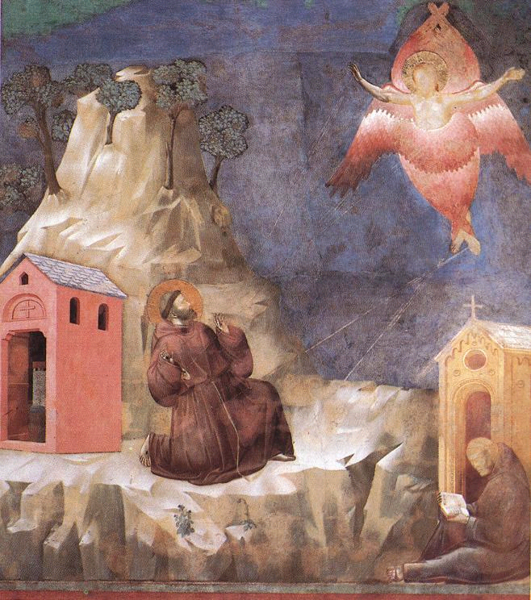
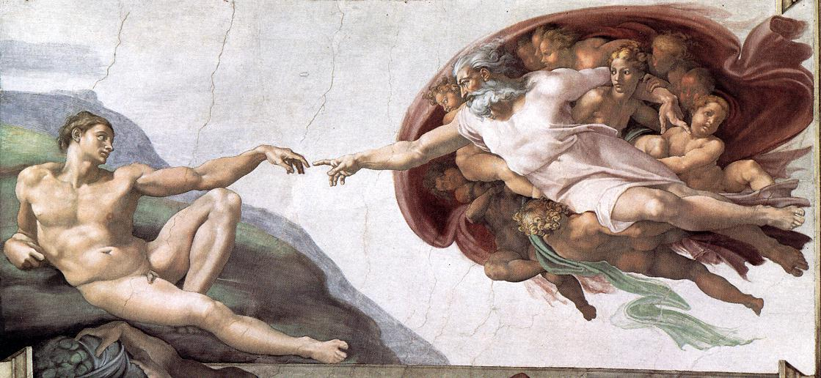
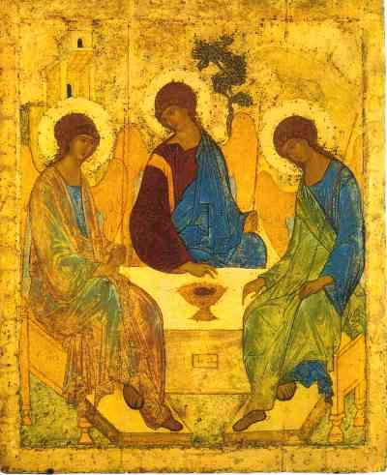

Slide 20
By the Hand of God

Slide 21
Friedrich Nebel
In Friedrich's, Nebel, it may be reasonable to consider that: the ship could represent the church Chateaubriand spoke of, anchored and secure; the ocean as God in an unassuming presence both still and bountiful; and the fog as a representation of the sorrows of the heart (Nancy Paruch).

Slide 22
What is Catholic world View?
God is:
Truth
Beauty
Goodnes
Whatever is true,
whatever is good,
whatever is beautiful!!!

Slide 23
The Last Supper
Da Vinci
Koder

Slide 24
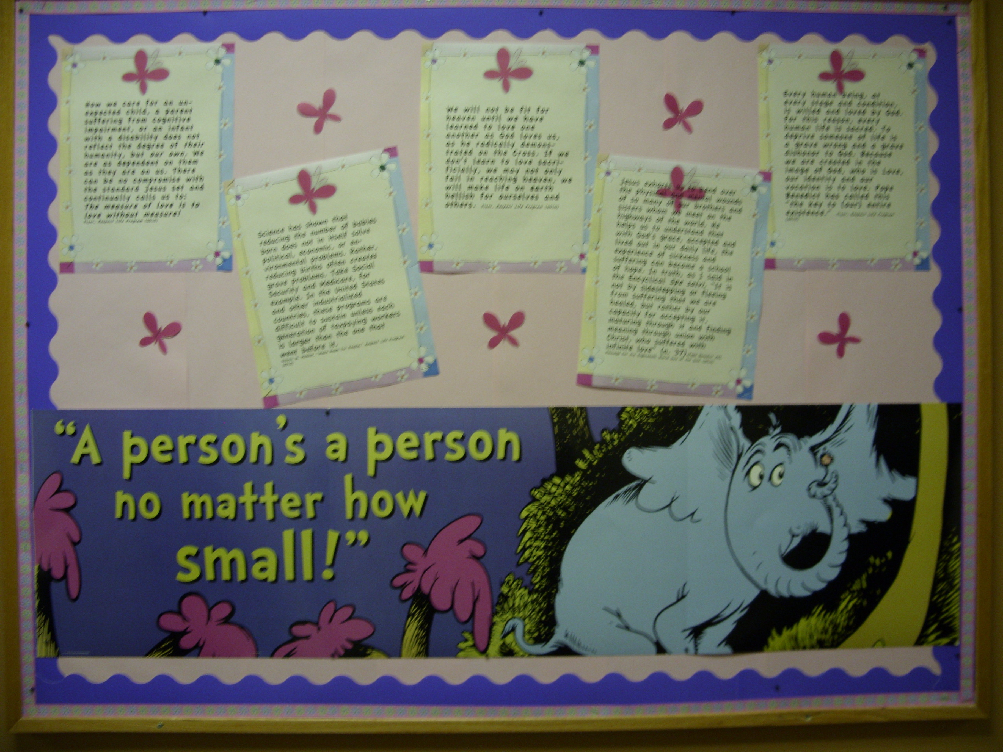

Slide 25
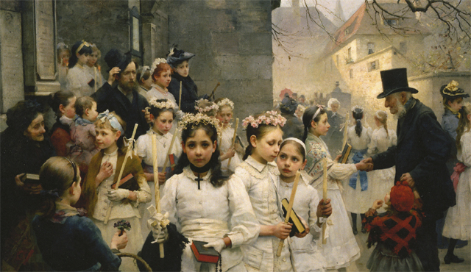

Slide 26
Lord of the Rings

Slide 27
Laudato Si

Slide 28
Bring it back to Jesus
Christmas trees
Rainbows
Easter Bunnies
Valentines
St. Patrick
President’s Day
Halloween
Veteran’s Day/Memorial Day
Fourth of July

Slide 29
Reader's Guide to Meals, Food and Table Fellowship in the New Testament, Jerome H. Neyrey University of Notre Dame

