Slide 1
Notes:
Good morning, my name is ____________________, I’ve been a parishioner here since _____________.
I love this parish, and I am happy to be here to tell you a little about the Charity and Development Appeal, or the CDA.
We have supported the CDA for _______X years.
We support the CDA because __________________.
(favorite charity or ministry?)

Slide 2
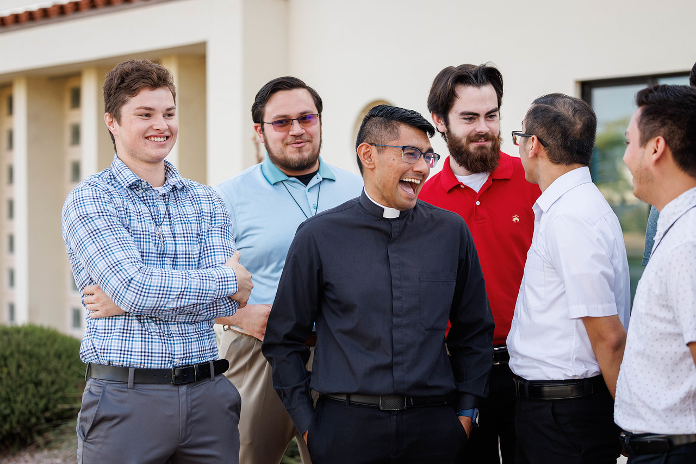
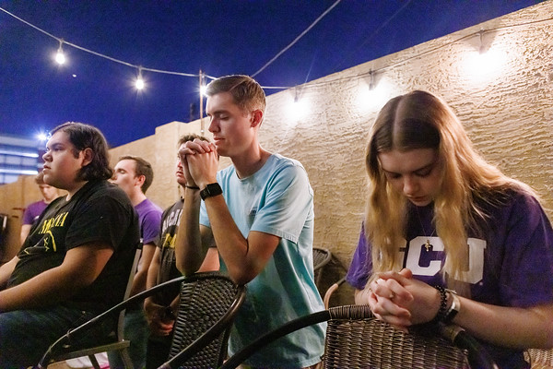
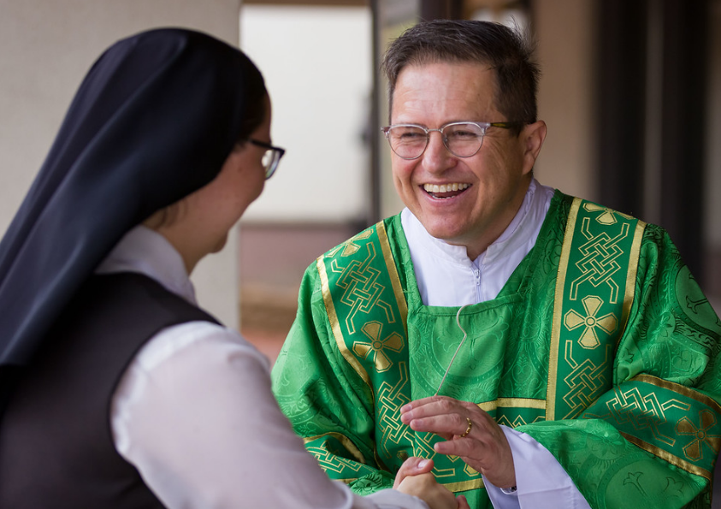
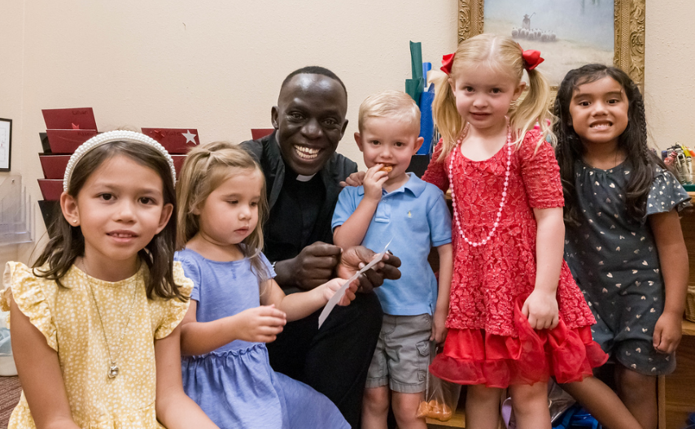
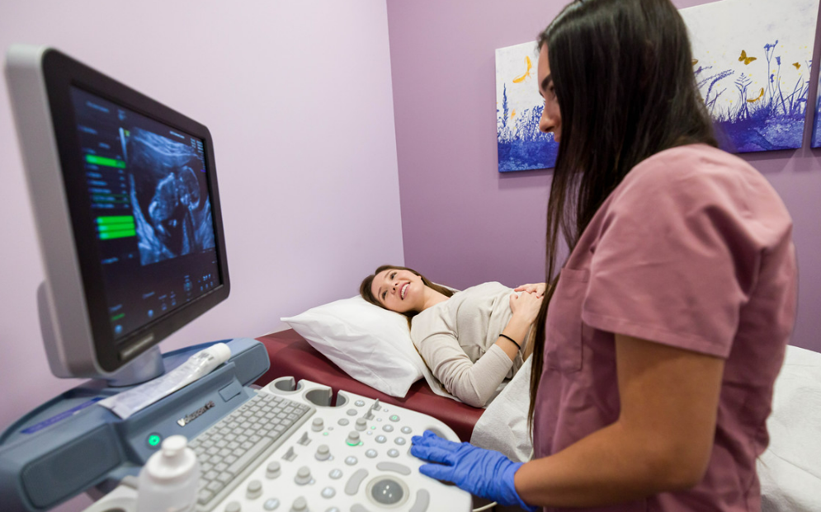
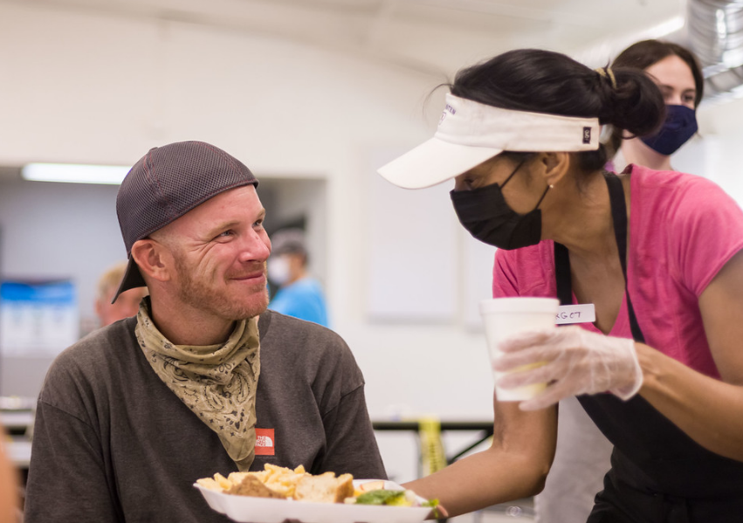
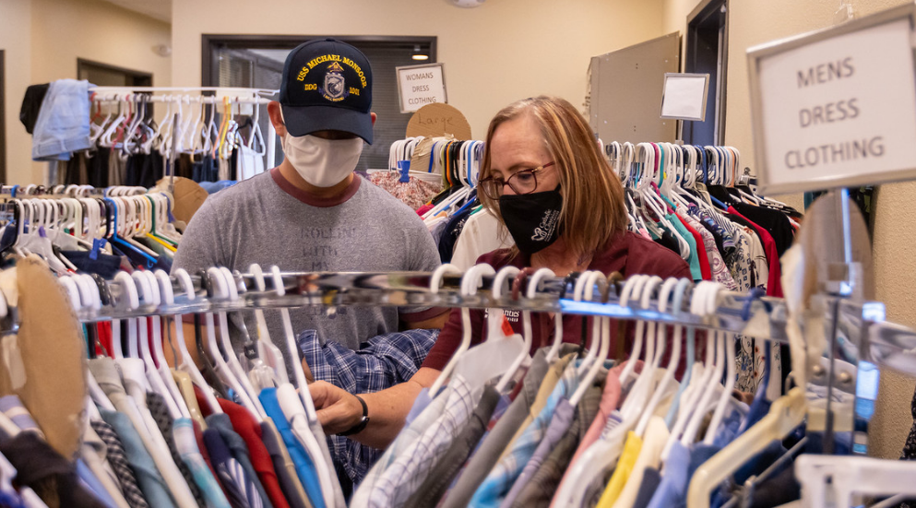
CDA funding helps seminarians and priests, programs and ministries for elderly, Catholic Newman Centers, Catholic schools, different programs for pregnant women, growing families, and the homeless. The Charity & Development Appeal funds 70+ Catholic ministries helping PEOPLE!!
Notes:
The CDA funds important people like seminarians and priests, programs for the elderly, young adults, kids in Catholic schools, 7 different women’s clinics, countless programs for young families, and even for the homeless. The CDA supports more than 70 different Catholic agencies and ministries helping people in need.

Slide 3
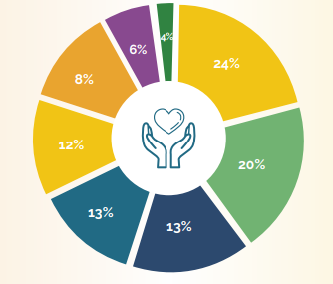
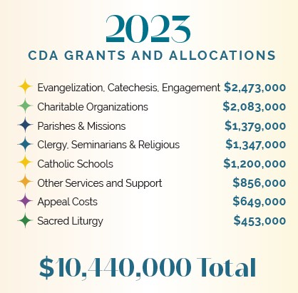
The CDA funds important things that no parish could support on its own
$10 MM+ in 2023 CDA grants!
Notes:
Did you know last year the CDA granted more than $10 million dollars to more than 70 Catholic ministries and charities? THANK YOU!!!
The CDA is the Charity & Development Appeal. It’s how we fund all the important things that we can’t do on our own here at <parish name> or as individuals.

Slide 4
the CDA needs…
Notes:
It takes a network of more than 20,000 families to support these great agencies, and the CDA needs YOU! And you. And you. It takes all of us, working together, to lift up others when they need help. Thank you – this work isn’t possible without YOU!

Slide 5
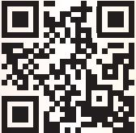
4 ways to give to the CDA
Online @
give.dphx.org
Commitment Card
Return to Parish
(or mail in yellow
return envelope)
Contact
602-354-2235
or email
DonorServices@dphx.org
Use the QR Code Card to make your gift online
Notes:
There are 4 ways to make your gift to the CDA….

Slide 6
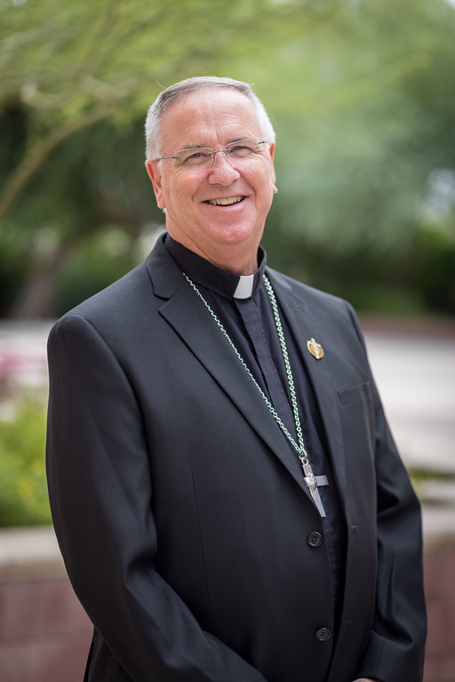
Notes:
On behalf of Father, Bishop Dolan, and all the fine folks who work and volunteer in more than 70 programs and missions funded by the CDA – THANK YOU!!
If you have any questions, please just grab me after Mass and I’d be happy to help you out.
THANKS AGAIN!

